Slide 1
Digital Design & Computer Arch. Lecture 21: Memory Overview, Organization & Technology
Prof. Onur Mutlu
ETH Zürich
Spring 2023
12 May 2023

Slide 2
Extra Credit Assignment 3: Amdahl’s Law
Paper review
G. M. Amdahl, “Validity of the single processor approach to achieving large scale computing capabilities,” AFIPS 1967.
Optional Assignment – for 1% extra credit
Write a 1-page review
Upload PDF file to Moodle – Deadline: June 15
Strongly recommended that you follow my guidelines for (paper) review

Slide 3
Readings for This Lecture and Next
Memory Hierarchy and Caches
Highly Recommended
H&H Chapters 8.1-8.3
Refresh: P&P Chapter 3.5
Kim & Mutlu, “Memory Systems,” Computing Handbook, 2014.
https://people.inf.ethz.ch/omutlu/pub/memory-systems-introduction_computing-handbook14.pdf
Recommended
An early cache paper by Maurice Wilkes
Wilkes, “Slave Memories and Dynamic Storage Allocation,” IEEE Trans. On Electronic Computers, 1965.

Slide 4
We Are Done With This…
Dataflow (at the ISA level)
Superscalar Execution
VLIW
Systolic Arrays
Decoupled Access Execute
SIMD Processing (Vector and Array processors)
Graphics Processing Units (GPUs)
Problem
Algorithm
Program/Language
System Software
SW/HW Interface
Micro-architecture
Logic
Devices
Electrons

Slide 5
Approaches to (Instruction-Level) Concurrency
Pipelining
Fine-Grained Multithreading
Out-of-order Execution
Dataflow (at the ISA level)
Superscalar Execution
VLIW
Systolic Arrays
Decoupled Access Execute
SIMD Processing (Vector and Array processors, GPUs)
Now you are very familiar with
many processing paradigms

Slide 6
Approaches to (Instruction-Level) Concurrency
Pipelining
Fine-Grained Multithreading
Out-of-order Execution
Dataflow (at the ISA level)
Superscalar Execution
VLIW
Systolic Arrays
Decoupled Access Execute
SIMD Processing (Vector and Array processors, GPUs)
Food for thought:
tradeoffs of these different processing paradigms

Slide 7
Tradeoffs of Processing Paradigms
Problem
Algorithm
Program/Language
System Software
SW/HW Interface
Micro-architecture
Logic
Devices
Electrons
Food for thought:
tradeoffs of these different processing paradigms

Slide 8
Tradeoffs of Processing Paradigms
Problem
Algorithm
Program/Language
System Software
SW/HW Interface
Micro-architecture
Logic
Devices
Electrons
Food for thought:
what determines the widespread success of a paradigm

Slide 9
Let Us Now Take A Step Back

Slide 10
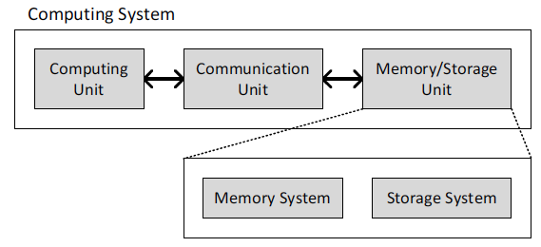
A Computing System
Three key components
Computation
Communication
Storage/memory
Burks, Goldstein, von Neumann, “Preliminary discussion of the
logical design of an electronic computing instrument,” 1946.
Image source: https://lbsitbytes2010.wordpress.com/2013/03/29/john-von-neumann-roll-no-15/

Slide 11
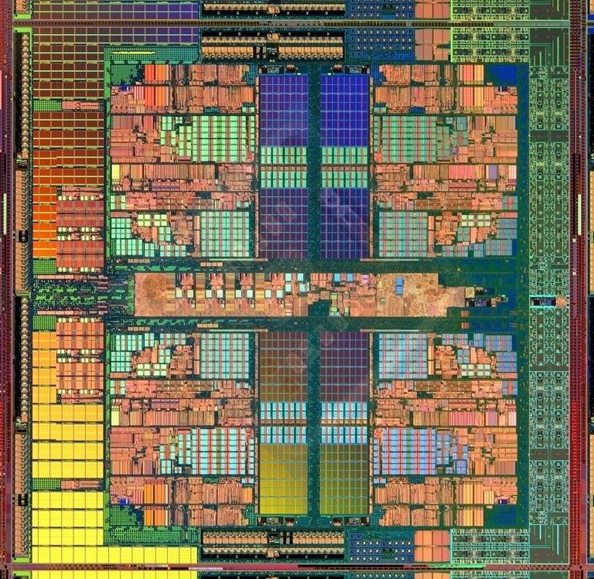
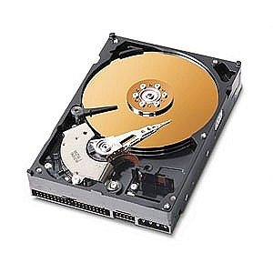
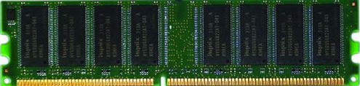
A Computing System
Three key components
Computation
Communication
Storage/memory
Burks, Goldstein, von Neumann, “Preliminary discussion of the
logical design of an electronic computing instrument,” 1946.
Image source: https://lbsitbytes2010.wordpress.com/2013/03/29/john-von-neumann-roll-no-15/

Slide 12
Recall: What is A Computer?
We will cover all three components
Processing
Memory
(program
and data)
I/O
control
(sequencing)
datapath

Slide 13
Memory Is Critically Important

Slide 14
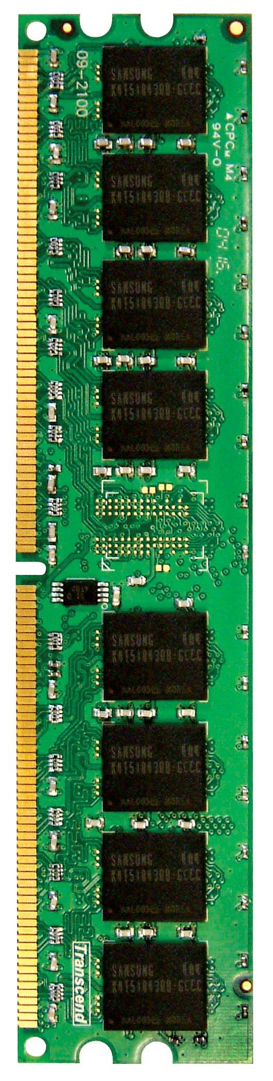
Memory in a Modern System
CORE 0
L2 CACHE 1
CORE 1
L2 CACHE 0
SHARED L3 CACHE
DRAM INTERFACE
DRAM MEMORY CONTROLLER
DRAM BANKS
L2 CACHE 2
CORE 3
CORE 2
L2 CACHE 3
AMD Barcelona, 2006

Slide 15
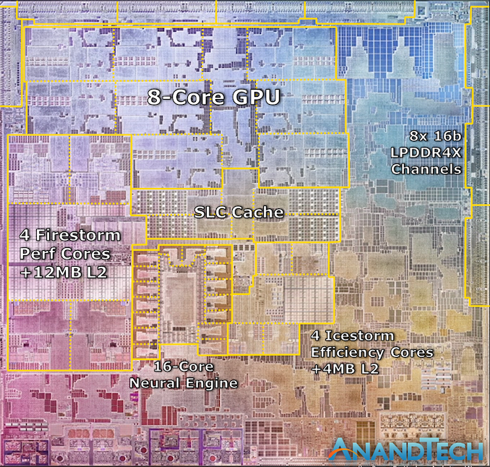
A Large Fraction of Modern Chips is Memory
Apple M1, 2021
Source: https://www.anandtech.com/show/16252/mac-mini-apple-m1-tested

Slide 16
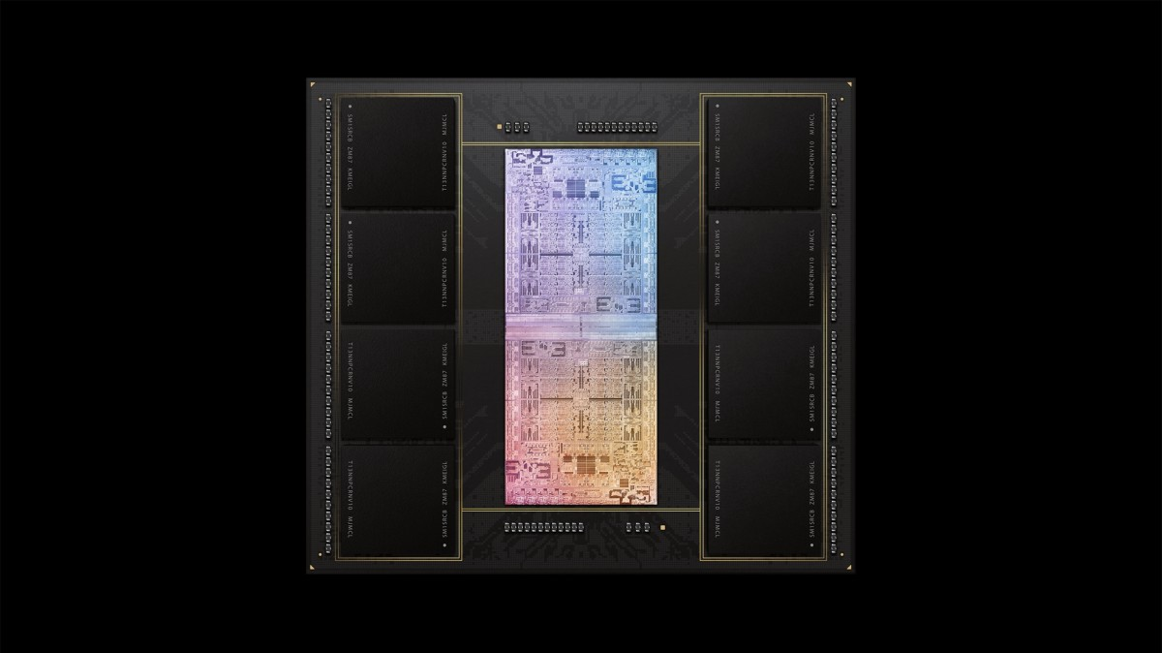
A Large Fraction of Modern Systems is Memory
A lot of
SRAM
Storage
DRAM
DRAM
Storage
Apple M1 Ultra System (2022)
https://www.gsmarena.com/apple_announces_m1_ultra_with_20core_cpu_and_64core_gpu-news-53481.php

Slide 17
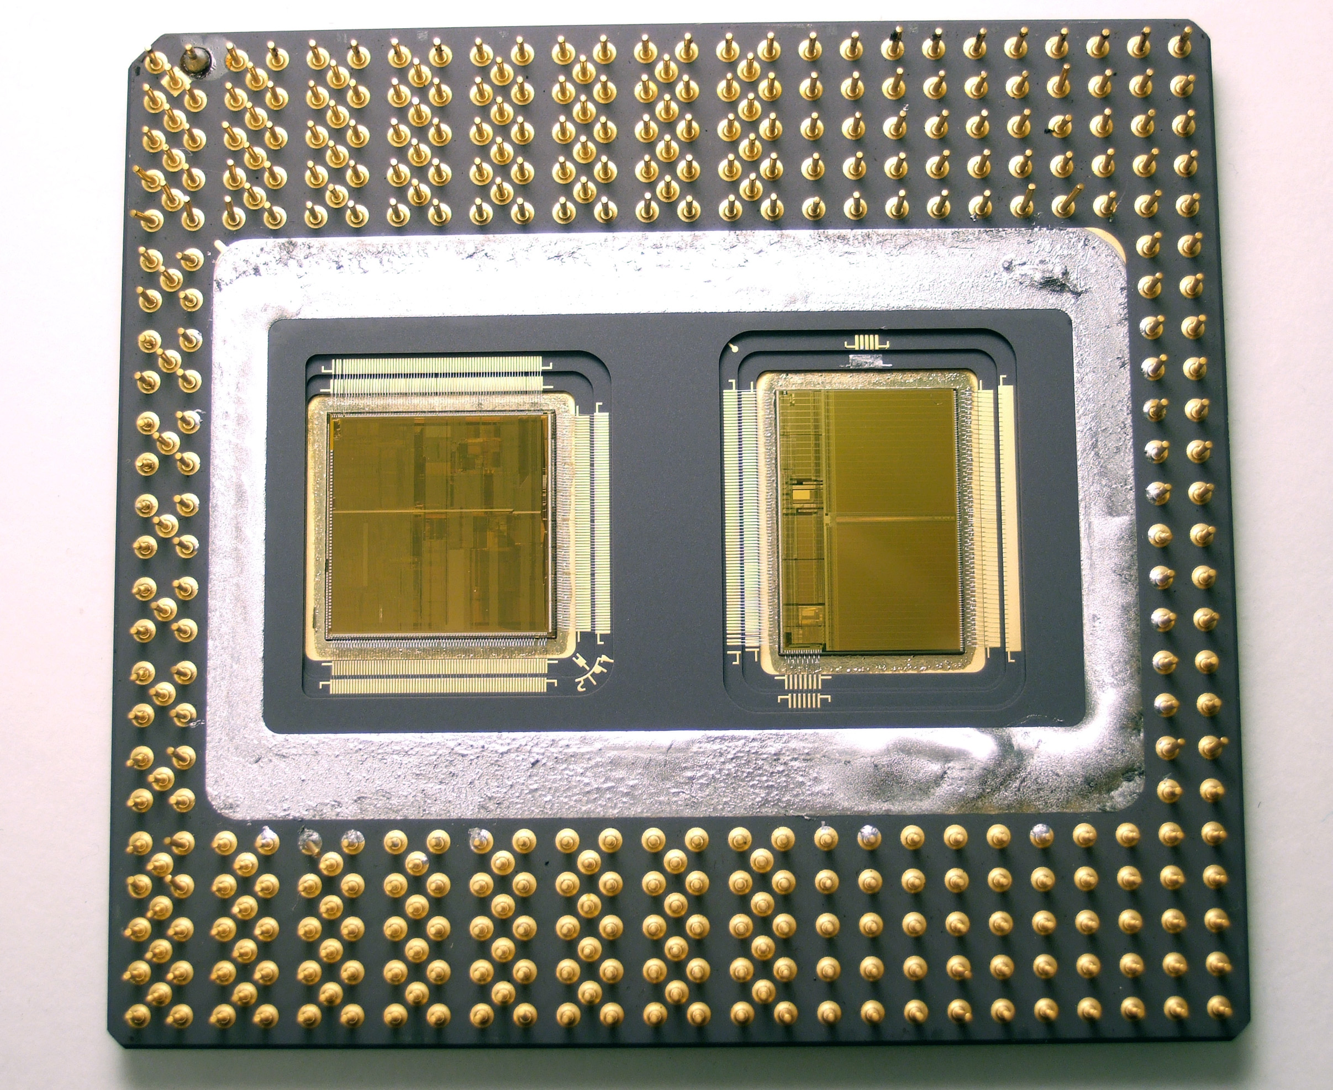
A Large Fraction of Modern Systems is Memory
Processor chip
Level 2 cache chip
Multi-chip module package
Intel Pentium Pro, 1995
By Moshen - http://en.wikipedia.org/wiki/Image:Pentiumpro_moshen.jpg, CC BY-SA 2.5, https://commons.wikimedia.org/w/index.php?curid=2262471

Slide 18
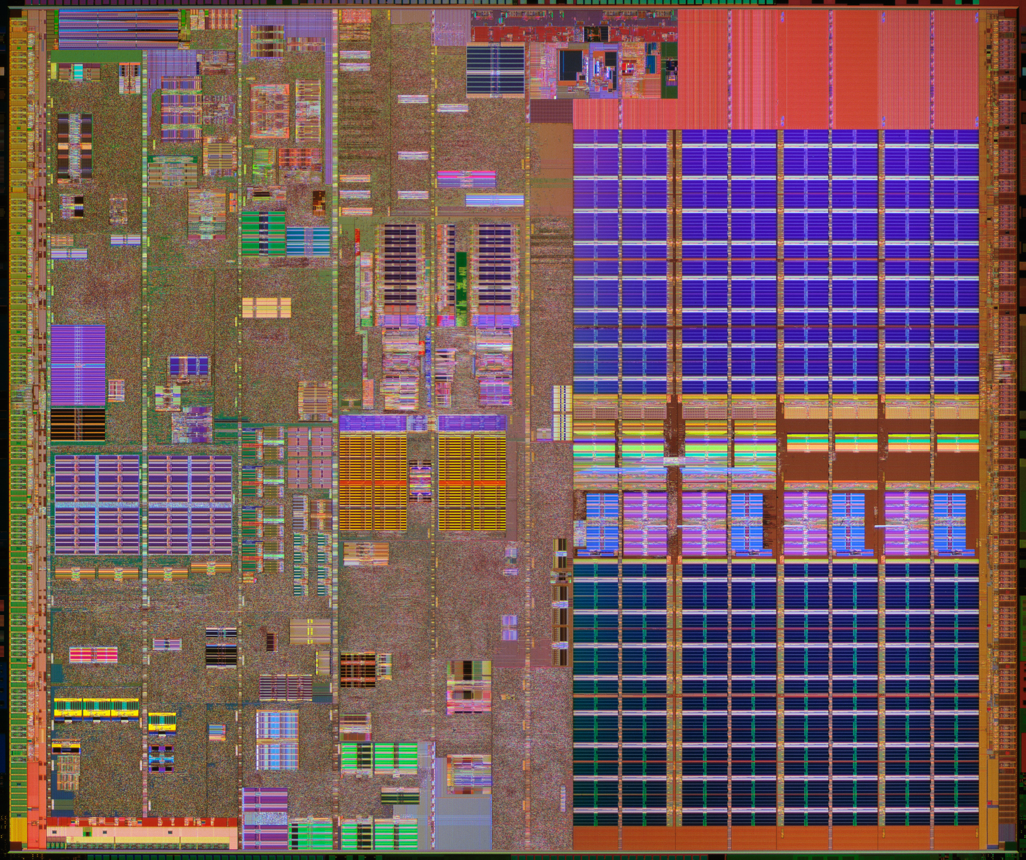
A Large Fraction of Modern Systems is Memory
L2 Cache
https://download.intel.com/newsroom/kits/40thanniversary/gallery/images/Pentium_4_6xx-die.jpg
Intel Pentium 4, 2000

Slide 19
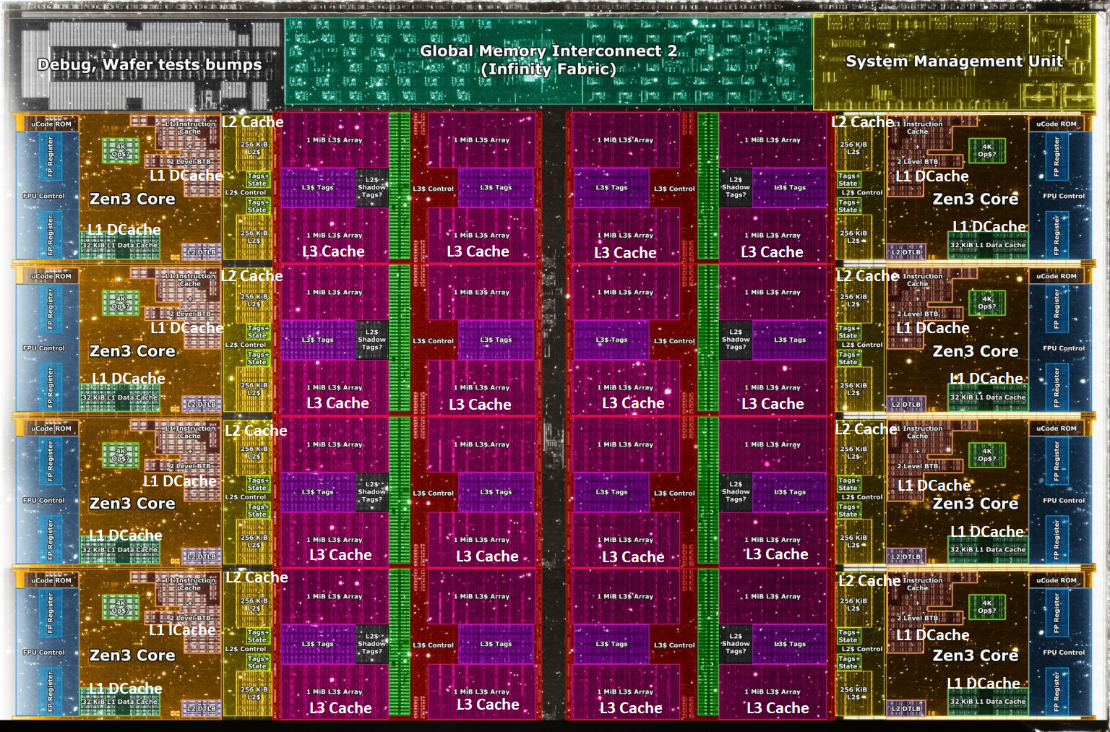
A Large Fraction of Modern Systems is Memory
Core Count:
8 cores/16 threads
L1 Caches:
32 KB per core
L2 Caches:
512 KB per core
L3 Cache:
32 MB shared
AMD Ryzen 5000, 2020
https://wccftech.com/amd-ryzen-5000-zen-3-vermeer-undressed-high-res-die-shots-close-ups-pictured-detailed/

Slide 20
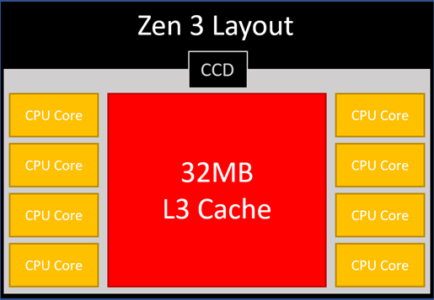
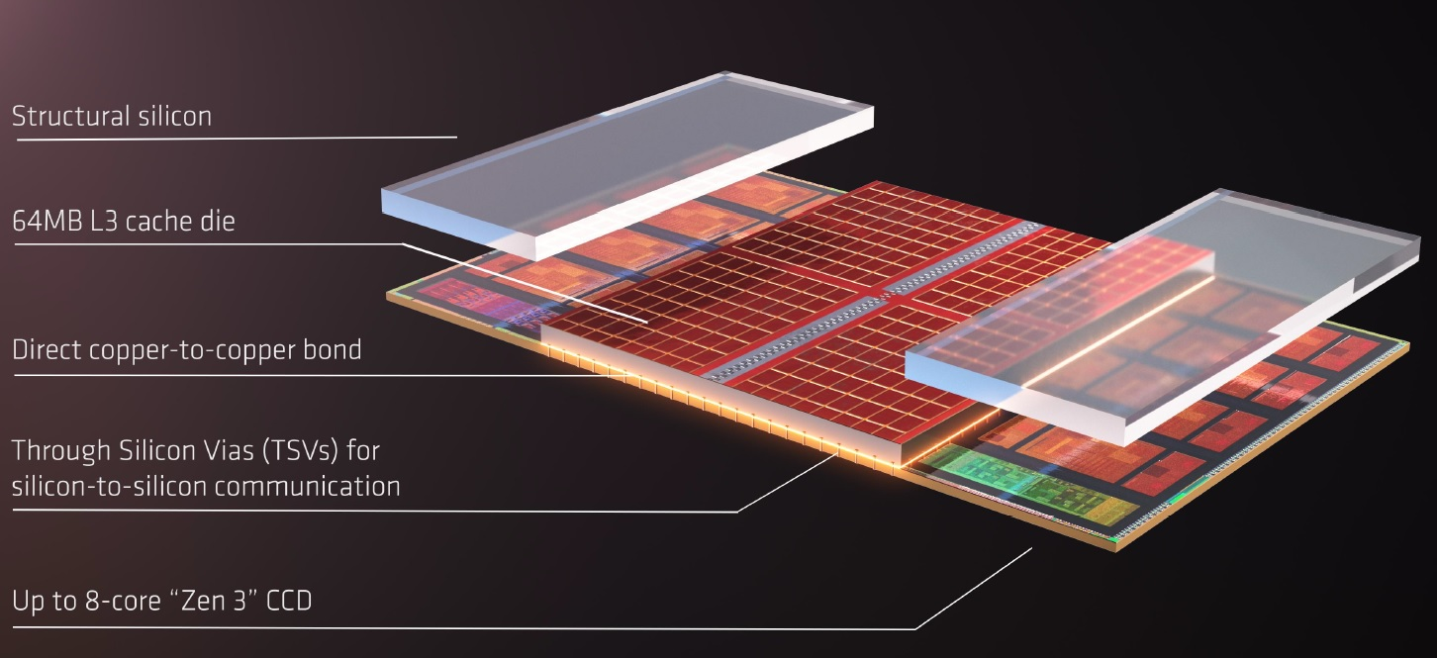
AMD’s 3D Last Level Cache (2021)
AMD increases the L3 size of their 8-core Zen 3 processors from 32 MB to 96 MB
Additional 64 MB L3 cache die stacked on top of the processor die
- Connected using Through Silicon Vias (TSVs)
- Total of 96 MB L3 cache
https://community.microcenter.com/discussion/5134/comparing-zen-3-to-zen-2
https://youtu.be/gqAYMx34euU
https://www.tech-critter.com/amd-keynote-computex-2021/
Notes:
CCD = Core Chiplet Die
Structural silicon is used to equalize the height and facilitate heat dissipation from the cores.

Slide 21
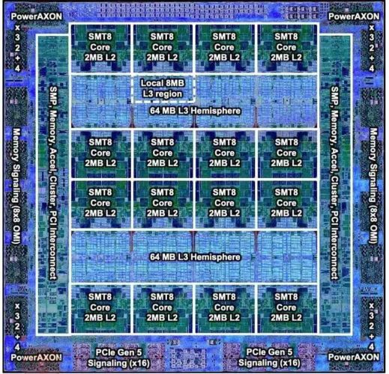
A Large Fraction of Modern Systems is Memory
IBM POWER10,
2020
Cores:
15-16 cores,
8 threads/core
L2 Caches:
2 MB per core
L3 Cache:
120 MB shared
https://www.it-techblog.de/ibm-power10-prozessor-mehr-speicher-mehr-tempo-mehr-sicherheit/09/2020/

Slide 22
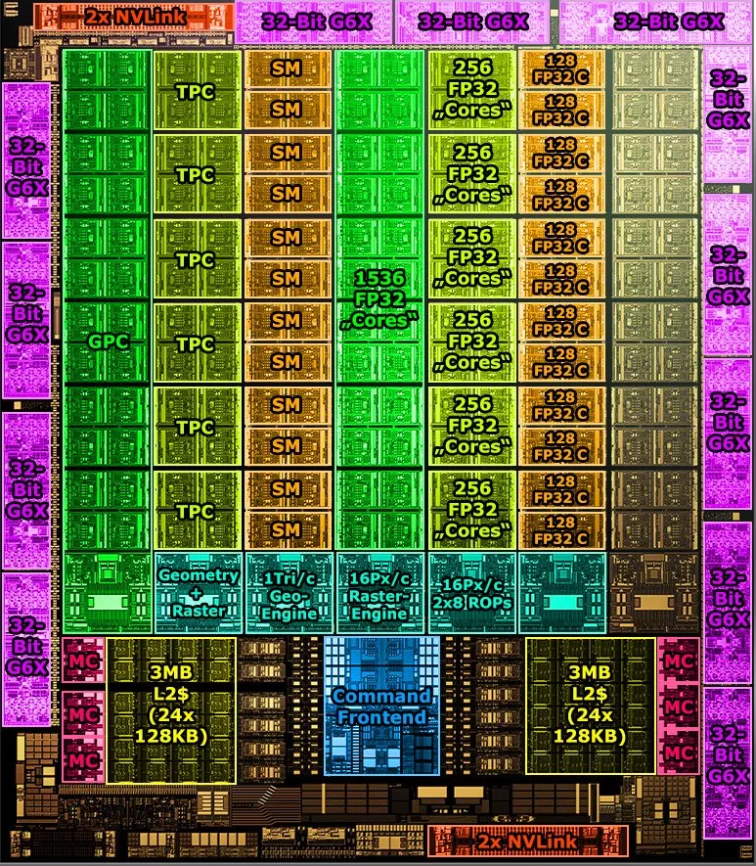
A Large Fraction of Modern Systems is Memory
Cores:
128 Streaming Multiprocessors
L1 Cache or Scratchpad:
192KB per SM
Can be used as L1 Cache and/or Scratchpad
L2 Cache:
40 MB shared
Nvidia Ampere, 2020
https://www.tomshardware.com/news/infrared-photographer-photos-nvidia-ga102-ampere-silicon

Slide 23
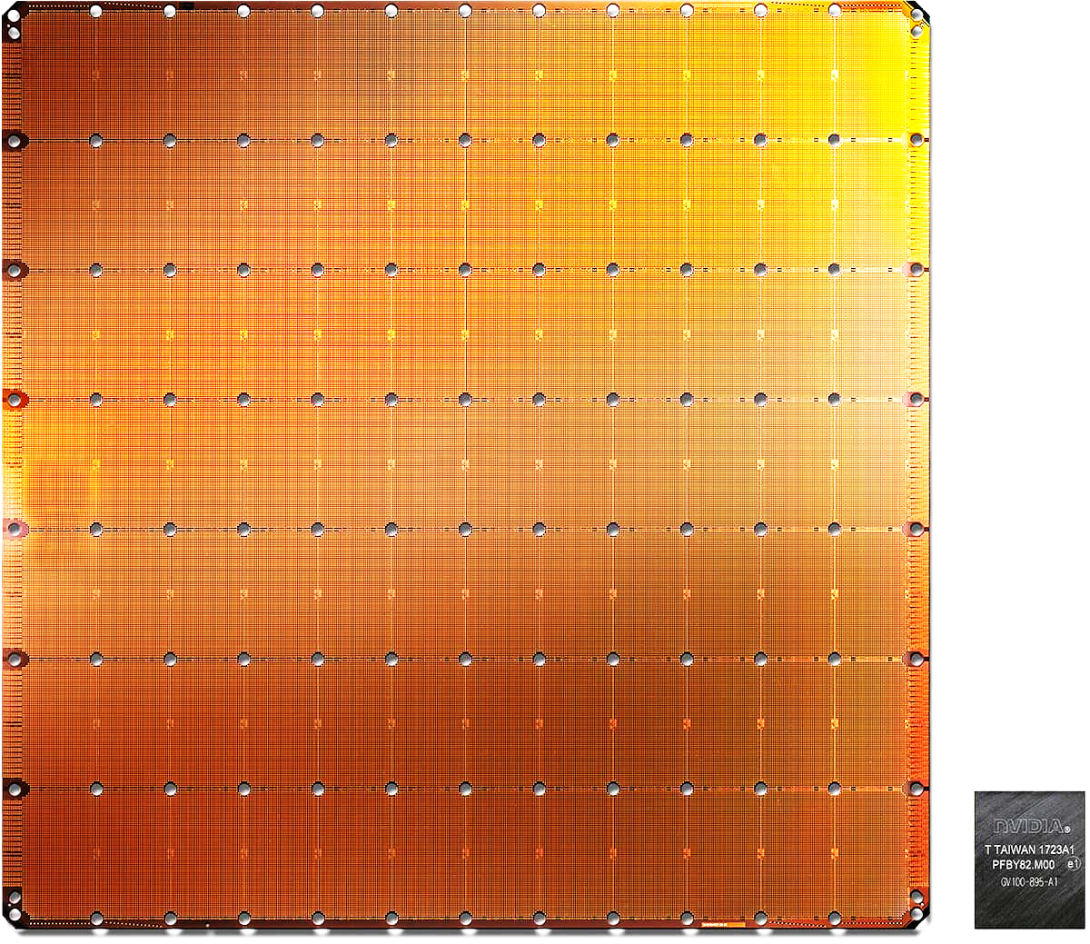
Cerebras’s Wafer Scale Engine (2019)
The largest ML accelerator chip
400,000 cores
18 GB of on-chip memory
9 PB/s memory bandwidth
Cerebras WSE
1.2 Trillion transistors
46,225 mm²
Largest GPU
21.1 Billion transistors
815 mm²
NVIDIA TITAN V
https://www.anandtech.com/show/14758/hot-chips-31-live-blogs-cerebras-wafer-scale-deep-learning
https://www.cerebras.net/cerebras-wafer-scale-engine-why-we-need-big-chips-for-deep-learning/
Notes:
The Wafer-Scale Engine is the most massive AI chip ever produced and packs a whopping 400,000 cores in a 46,225mm2 footprint.

Slide 24
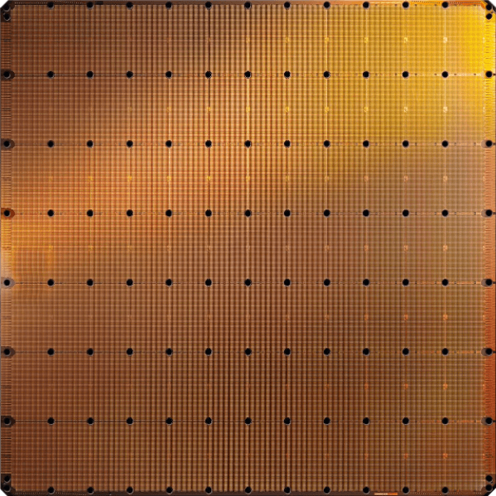
Cerebras’s Wafer Scale Engine-2 (2021)
The largest ML accelerator chip
850,000 cores
40 GB of on-chip memory
20 PB/s memory bandwidth
Cerebras WSE-2
2.6 Trillion transistors
46,225 mm²
Largest GPU
54.2 Billion transistors
826 mm²
NVIDIA Ampere GA100
https://cerebras.net/product/#overview

Slide 25
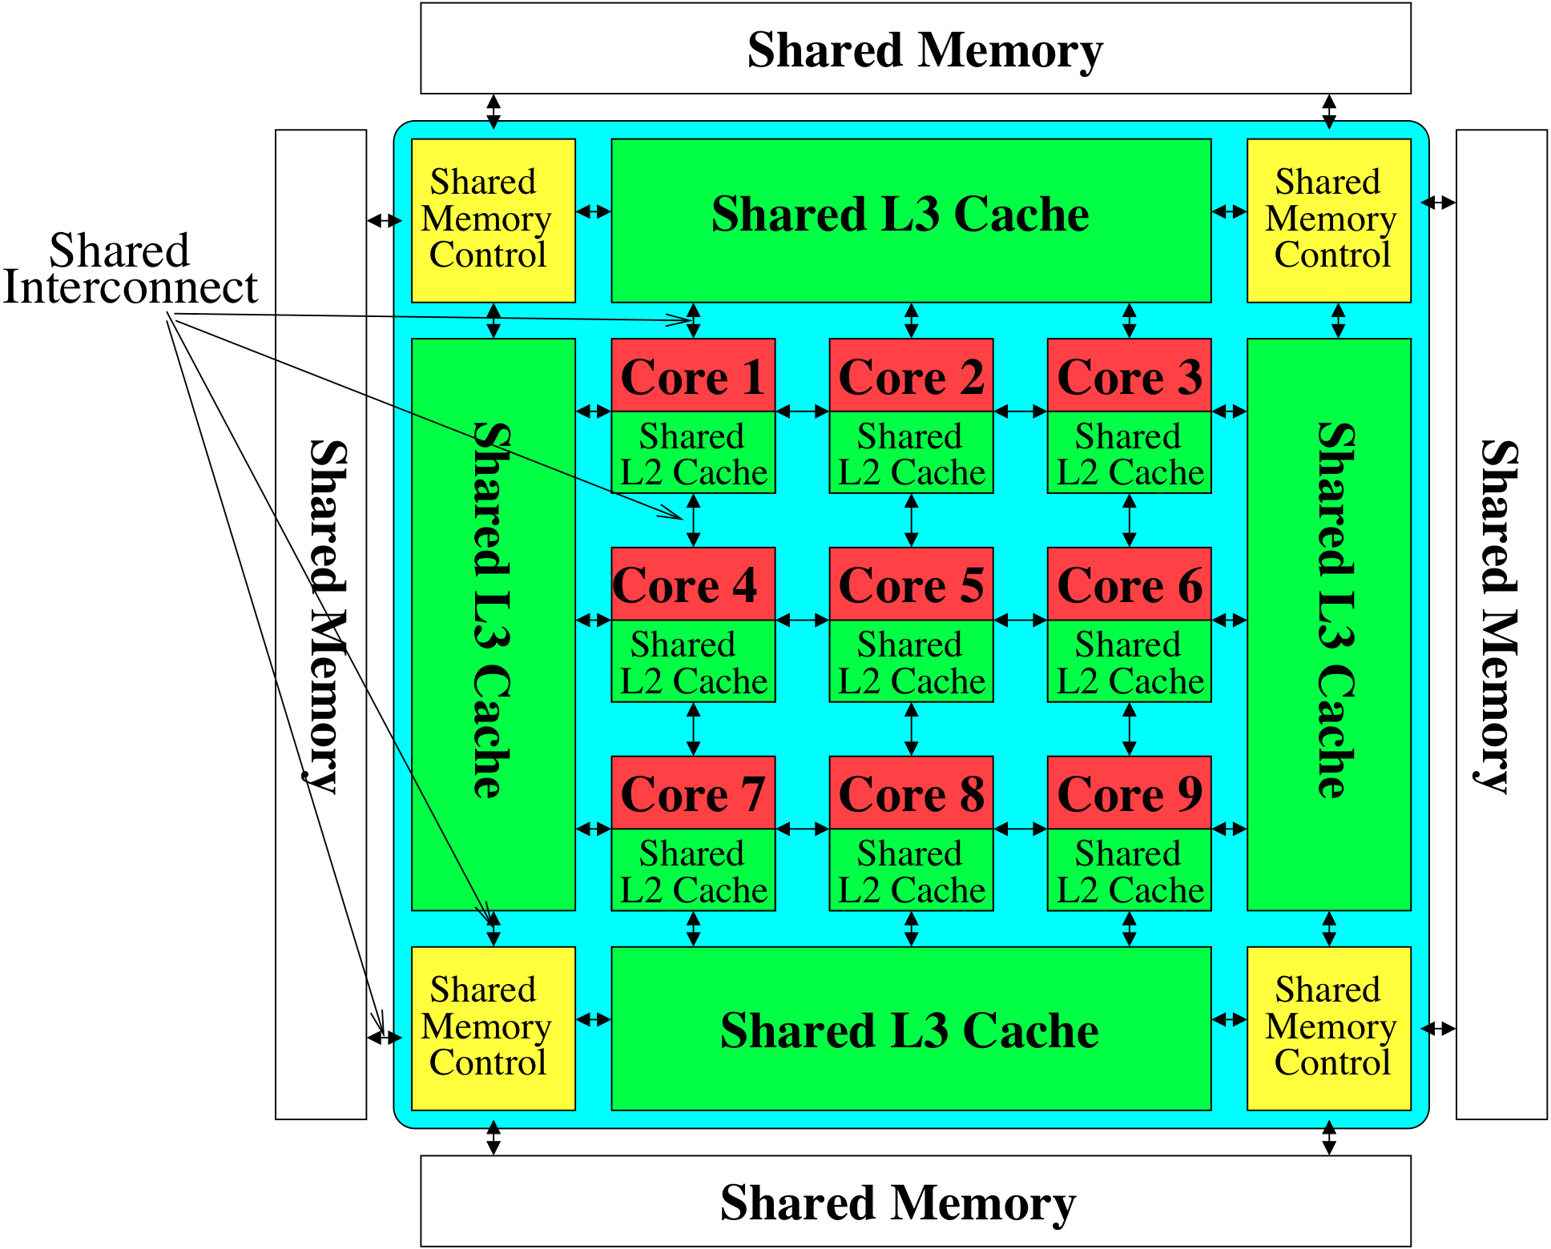
Memory System: Most of the Platform
Storage
Most of the system is dedicated to storing and moving data
Yet, system is still bottlenecked by memory

Slide 26
Memory is Critical for Performance
We have seen it many times in this course
Load-related stalls in pipelining
Even with magic “1-cycle” memory assumption
Load/store handling in OoO execution processors
OoO execution and memory latency tolerance
VLIW stalls due to long-latency memory operations
VLIW memory bank disambiguation in compilers
Many memory banks needed in SIMD processors
SIMD vector processing performance example
GPU register files and high-bandwidth memory systems
High-bandwidth memory for modern systolic arrays
Fine-grained multithreading to tolerate memory latency
…

Slide 27
The Reason
Computing
is Bottlenecked by Data

Slide 28
Computation is Bottlenecked by Memory
Important workloads are all data intensive
ML/AI, Genomics, Data Analytics, Databases, Graph Analytics, …
They require rapid and efficient processing of large amounts of data
Data is increasing
We can generate much more than we can process

Slide 29
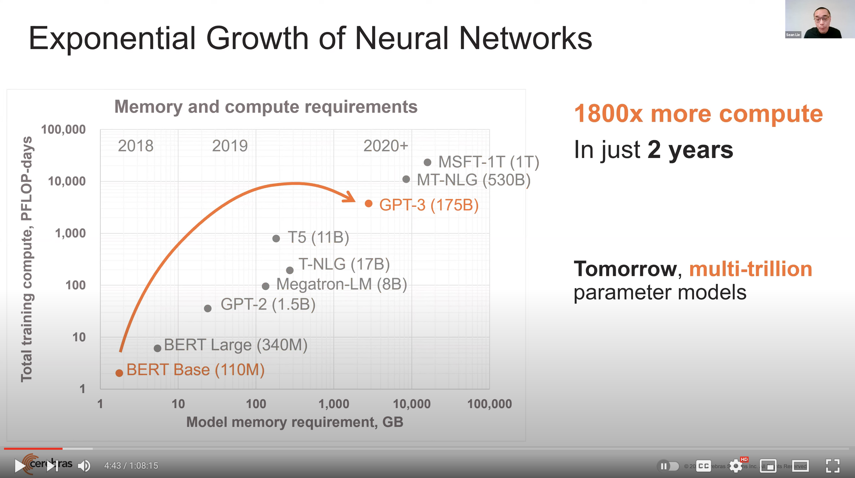
Huge Demand for Performance & Efficiency
Source: https://youtu.be/Bh13Idwcb0Q?t=283

Slide 30
Application Perspective

Slide 31




Memory Is Critical for Performance (I)
In-memory Databases
[Mao+, EuroSys’12; Clapp+ (Intel), IISWC’15]
Graph/Tree Processing
[Xu+, IISWC’12; Umuroglu+, FPL’15]
In-Memory Data Analytics
[Clapp+ (Intel), IISWC’15;
Awan+, BDCloud’15]
Datacenter Workloads [Kanev+ (Google), ISCA’15]

Slide 32
Memory Is Critical for Performance (I)
In-memory Databases
[Mao+, EuroSys’12; Clapp+ (Intel), IISWC’15]
Graph/Tree Processing
[Xu+, IISWC’12; Umuroglu+, FPL’15]
Memory → bottleneck
In-Memory Data Analytics
[Clapp+ (Intel), IISWC’15;
Awan+, BDCloud’15]
Datacenter Workloads [Kanev+ (Google), ISCA’15]

Slide 33






Memory Is Critical for Performance (II)
Chrome
TensorFlow Mobile
Google’s web browser
Google’s machine learning framework
Video Playback
Video Capture
Google’s video codec
Google’s video codec
Notes:
In this work, we take a look at widely-used google consumer workloads, to figure out the major sources of energy consumption.
We look at Google Chrome web brower. We take a look at Tensorflow, Google’s machine learning framework, and we also take a look at two important video related workloads, video playback and video capture, both rely on Google’s vp9 codec technology.

Slide 34
Memory Is Critical for Performance (II)
Chrome
TensorFlow Mobile
Google’s web browser
Google’s machine learning framework
Memory → bottleneck
Video Playback
Video Capture
Google’s video codec
Google’s video codec
Notes:
In this work, we take a look at widely-used google consumer workloads, to figure out the major sources of energy consumption.
We look at Google Chrome web brower. We take a look at Tensorflow, Google’s machine learning framework, and we also take a look at two important video related workloads, video playback and video capture, both rely on Google’s vp9 codec technology.

Slide 35
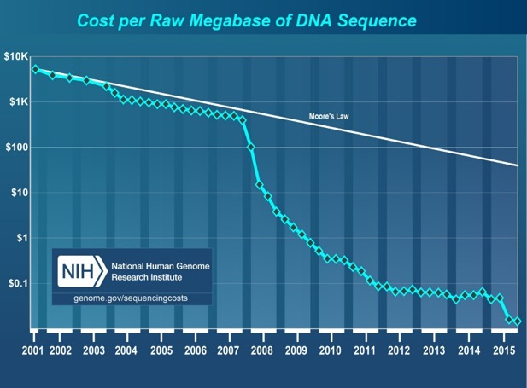
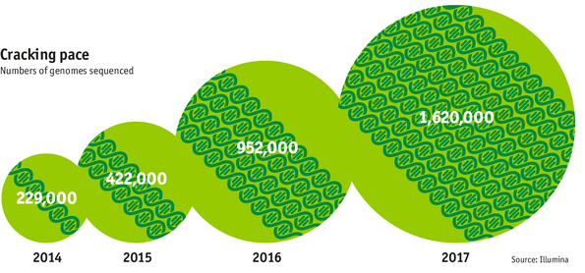

Data is Key for Modern & Future Workloads
development of high-throughput sequencing (HTS) technologies
Number of Genomes Sequenced
http://www.economist.com/news/21631808-so-much-genetic-data-so-many-uses-genes-unzipped
Notes:
However, since the development of high throughput sequencing (HTS) technologies, the cost of genome sequencing has fallen off a cliff (<< 1,000$) making it viable for almost everyone's use.

Slide 36

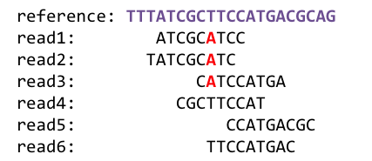
1
Sequencing
Genome Analysis
Read Mapping
2
Variant Calling
Scientific Discovery
3
4
Notes:
Genome analysis starts with sequencing random short DNA fragments of copies of the original molecule.
Unfortunately, these reads lack information about their order and which part of genome they are originated from.
Hence the second step is to map these reads to a long reference genome.

Slide 37
1
Sequencing
Genome Analysis
Read Mapping
2
Memory → bottleneck
Variant Calling
Scientific Discovery
3
4
Notes:
Genome analysis starts with sequencing random short DNA fragments of copies of the original molecule.
Unfortunately, these reads lack information about their order and which part of genome they are originated from.
Hence the second step is to map these reads to a long reference genome.

Slide 38
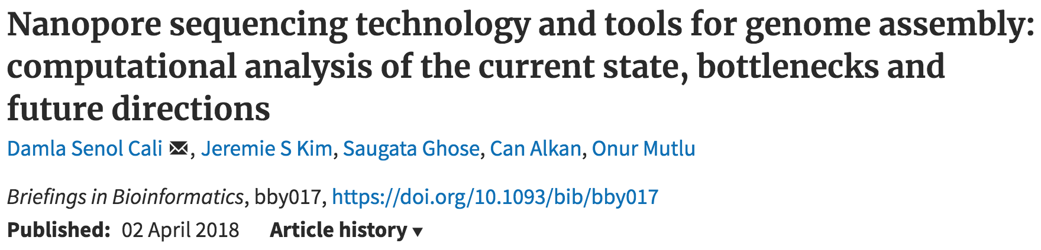
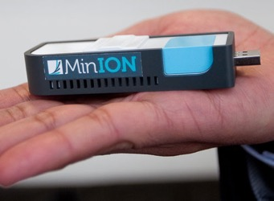
New Genome Sequencing Technologies
Oxford Nanopore MinION
Senol Cali+, “Nanopore Sequencing Technology and Tools for Genome
Assembly: Computational Analysis of the Current State, Bottlenecks
and Future Directions,” Briefings in Bioinformatics, 2018.
[Open arxiv.org version]

Slide 39
New Genome Sequencing Technologies
Oxford Nanopore MinION
Memory → bottleneck
Senol Cali+, “Nanopore Sequencing Technology and Tools for Genome
Assembly: Computational Analysis of the Current State, Bottlenecks
and Future Directions,” Briefings in Bioinformatics, 2018.
[Preliminary arxiv.org version]

Slide 40




We Need Faster & Scalable Genome Analysis
Understanding genetic variations, species, evolution, …
Predicting the presence and relative abundance of microbes in a sample
Rapid surveillance of disease outbreaks
Developing personalized medicine
And, many, many other applications …
Notes:
Knowing what organisms are present in a given environmental sample and how abundant are they

Slide 41

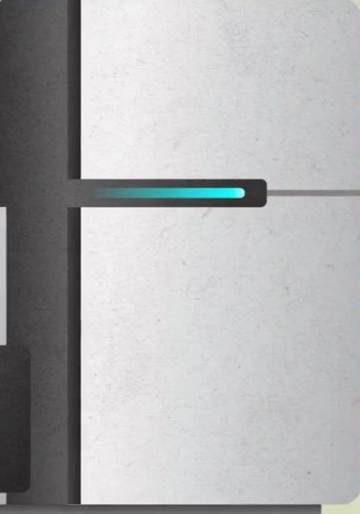
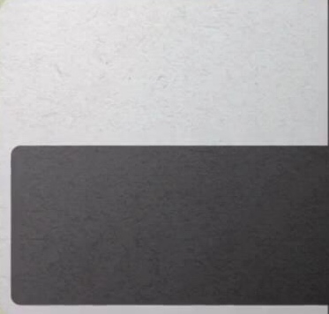
Problems with (Genome) Analysis Today
Special-Purpose Machine
for Data Generation
General-Purpose Machine
for Data Analysis
FAST SLOW
Slow and inefficient processing capability
Large amounts of data movement
This picture is similar for many “data generators & analyzers” today

Slide 42
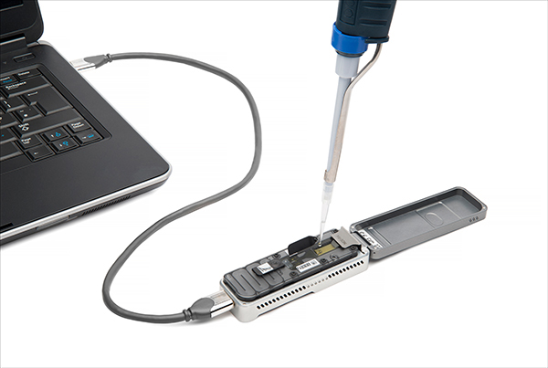
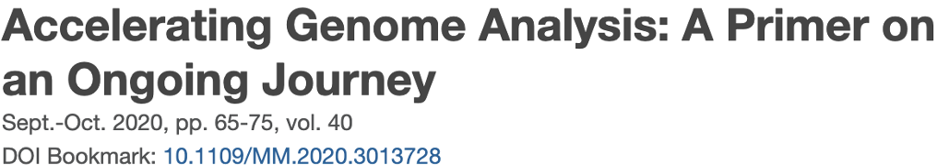
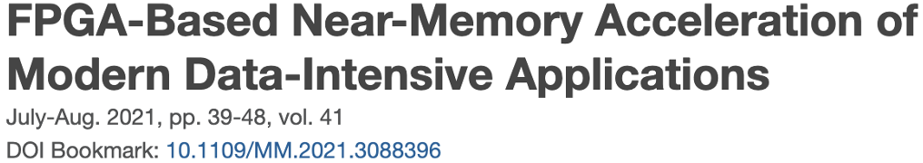
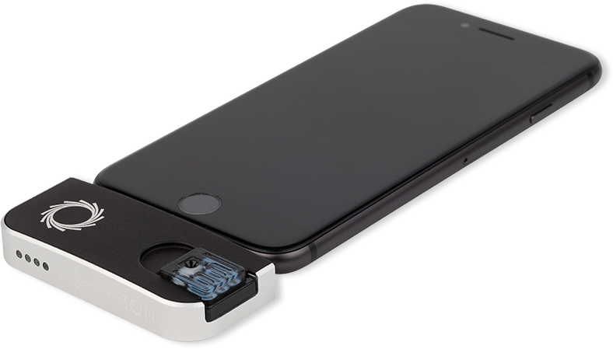
Future of Genome Sequencing & Analysis
Mohammed Alser, Zülal Bingöl, Damla Senol Cali, Jeremie Kim, Saugata Ghose, Can Alkan, Onur Mutlu
“Accelerating Genome Analysis: A Primer on an Ongoing Journey” IEEE Micro, August 2020.
MinION from ONT
SmidgION from ONT

Slide 43
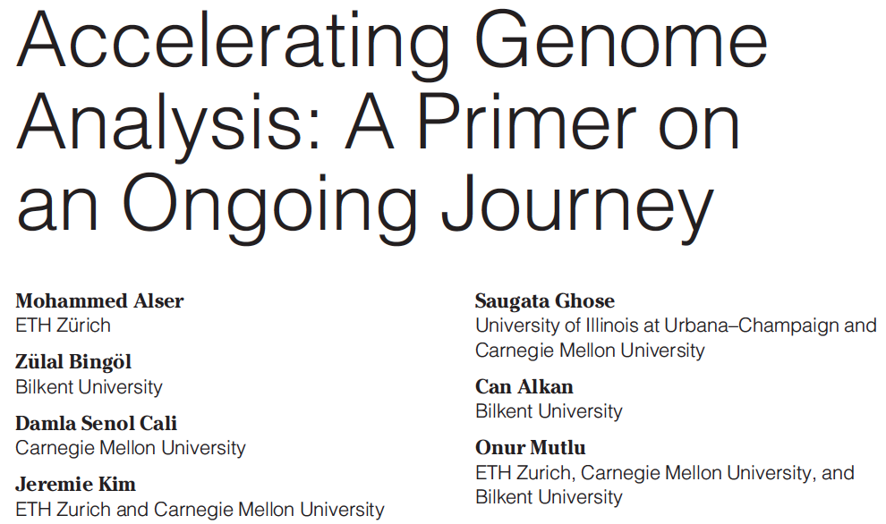
Accelerating Genome Analysis
Mohammed Alser, Zulal Bingol, Damla Senol Cali, Jeremie Kim, Saugata Ghose, Can Alkan, and Onur Mutlu, "Accelerating Genome Analysis: A Primer on an Ongoing Journey" IEEE Micro (IEEE MICRO), Vol. 40, No. 5, pages 65-75, September/October 2020. [Slides (pptx)(pdf)] [Talk Video (1 hour 2 minutes)]

Slide 44
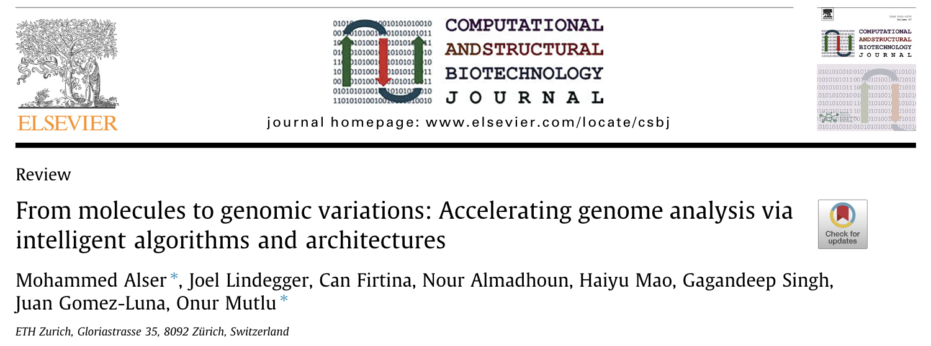
Beginner Reading on Genome Analysis
Mohammed Alser, Joel Lindegger, Can Firtina, Nour Almadhoun, Haiyu Mao, Gagandeep Singh, Juan Gomez-Luna, Onur Mutlu
“From Molecules to Genomic Variations to Scientific Discovery: Intelligent Algorithms and Architectures for Intelligent Genome Analysis”
Computational and Structural Biotechnology Journal, 2022
[Source code]
https://arxiv.org/pdf/2205.07957.pdf

Slide 45
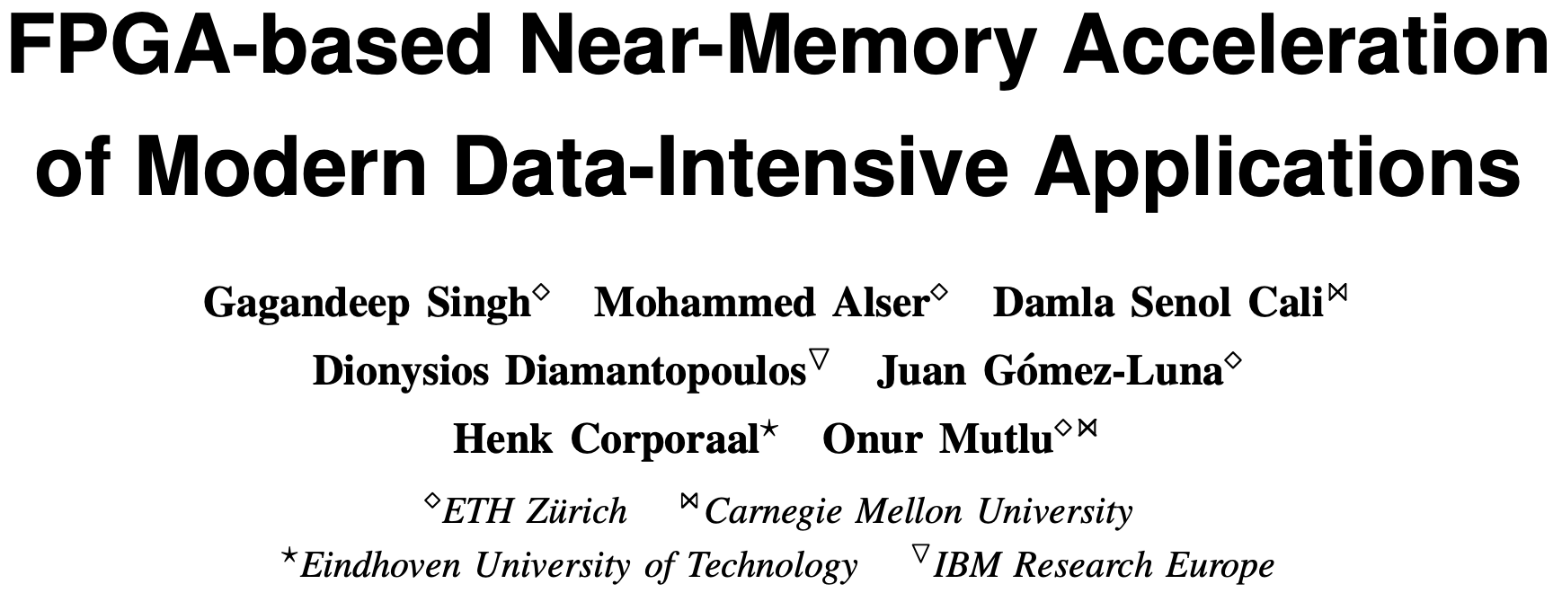
FPGA-based Near-Memory Analytics
Gagandeep Singh, Mohammed Alser, Damla Senol Cali, Dionysios Diamantopoulos, Juan Gómez-Luna, Henk Corporaal, and Onur Mutlu, "FPGA-based Near-Memory Acceleration of Modern Data-Intensive Applications" IEEE Micro (IEEE MICRO), 2021.

Slide 46
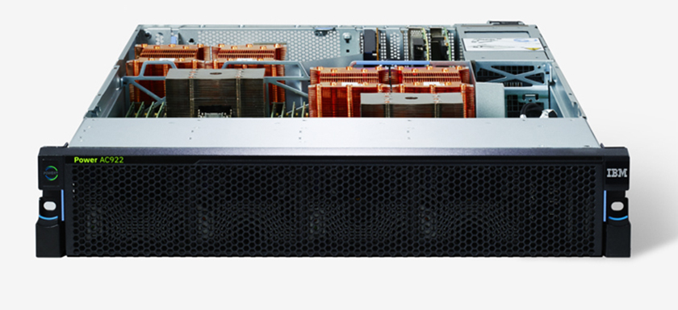
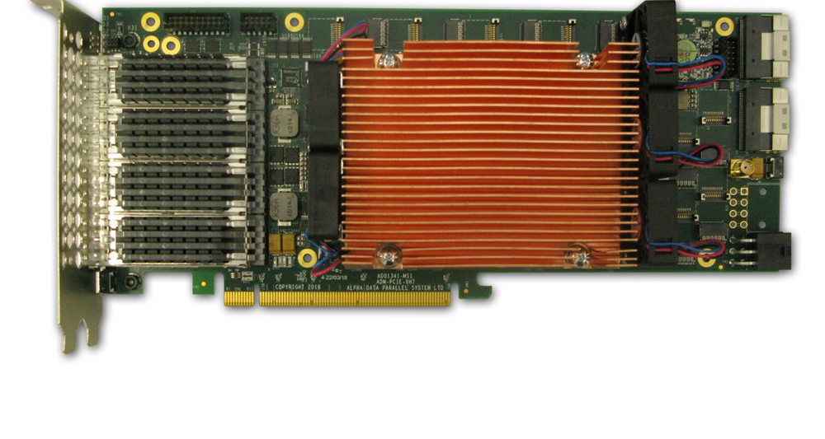
Near-Memory Acceleration using FPGAs
OCAPI
Source: IBM
Source: AlphaData
IBM POWER9 CPU
HBM-based FPGA board
Near-HBM FPGA-based accelerator
Two communication technologies: CAPI2 and OCAPI
Two memory technologies: DDR4 and HBM
Two workloads: Weather Modeling and Genome Analysis
Notes:
To this end we build a [CLICK] near-HBM FPGA based accelerator which is connected to a server-grade IBM POWER9-based CPU system

Slide 47
Performance & Energy Greatly Improve
5-27× performance vs. a 16-core (64-thread) IBM POWER9 CPU
12-133× energy efficiency vs. a 16-core (64-thread) IBM POWER9 CPU
HBM alleviates memory bandwidth contention vs. DDR4
Notes:
[CLICK]

Slide 48
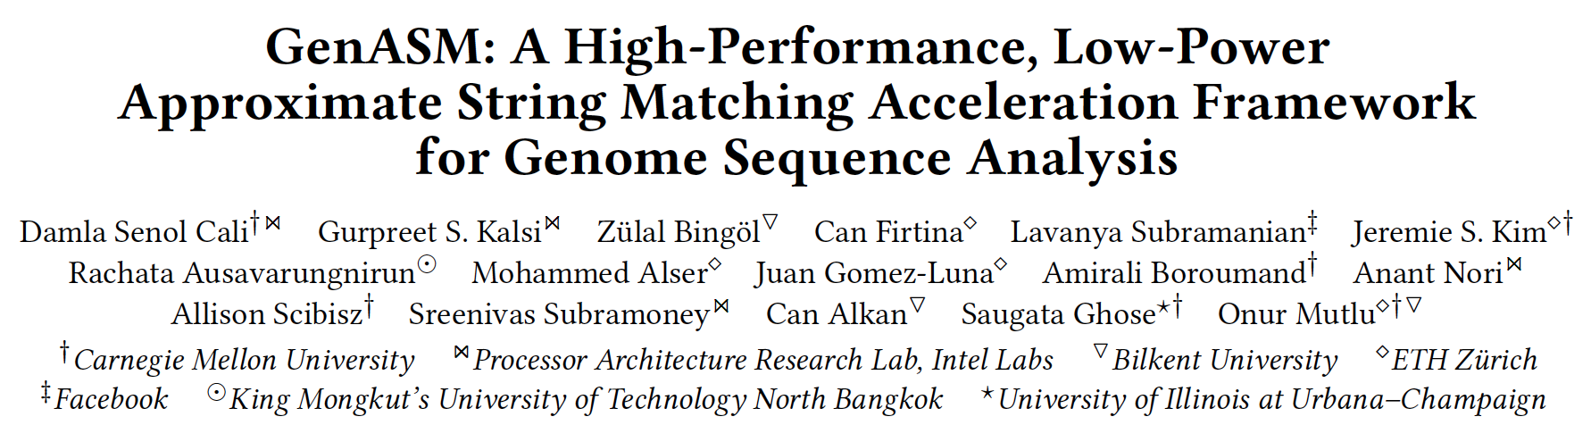
GenASM Acceleration Framework [MICRO 2020]
Damla Senol Cali, Gurpreet S. Kalsi, Zulal Bingol, Can Firtina, Lavanya Subramanian, Jeremie S. Kim, Rachata Ausavarungnirun, Mohammed Alser, Juan Gomez-Luna, Amirali Boroumand, Anant Nori, Allison Scibisz, Sreenivas Subramoney, Can Alkan, Saugata Ghose, and Onur Mutlu, "GenASM: A High-Performance, Low-Power Approximate String Matching Acceleration Framework for Genome Sequence Analysis" Proceedings of the 53rd International Symposium on Microarchitecture (MICRO), Virtual, October 2020. [Lighting Talk Video (1.5 minutes)] [Lightning Talk Slides (pptx) (pdf)] [Talk Video (18 minutes)] [Slides (pptx) (pdf)]

Slide 49
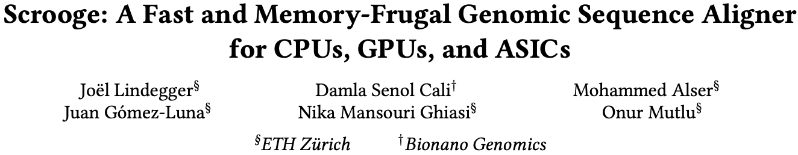
Scrooge: Overcoming GenASM Limitations
Joël Lindegger, Damla Senol Cali, Mohammed Alser, Juan Gómez-Luna, Nika Mansouri Ghiasi, and Onur Mutlu, "Scrooge: A Fast and Memory-Frugal Genomic Sequence Aligner for CPUs, GPUs, and ASICs" Bioinformatics, [published online on] 24 March 2023. [Online link at Bioinformatics Journal] [arXiv preprint] [Scrooge Source Code]
https://arxiv.org/pdf/2208.09985.pdf

Slide 50
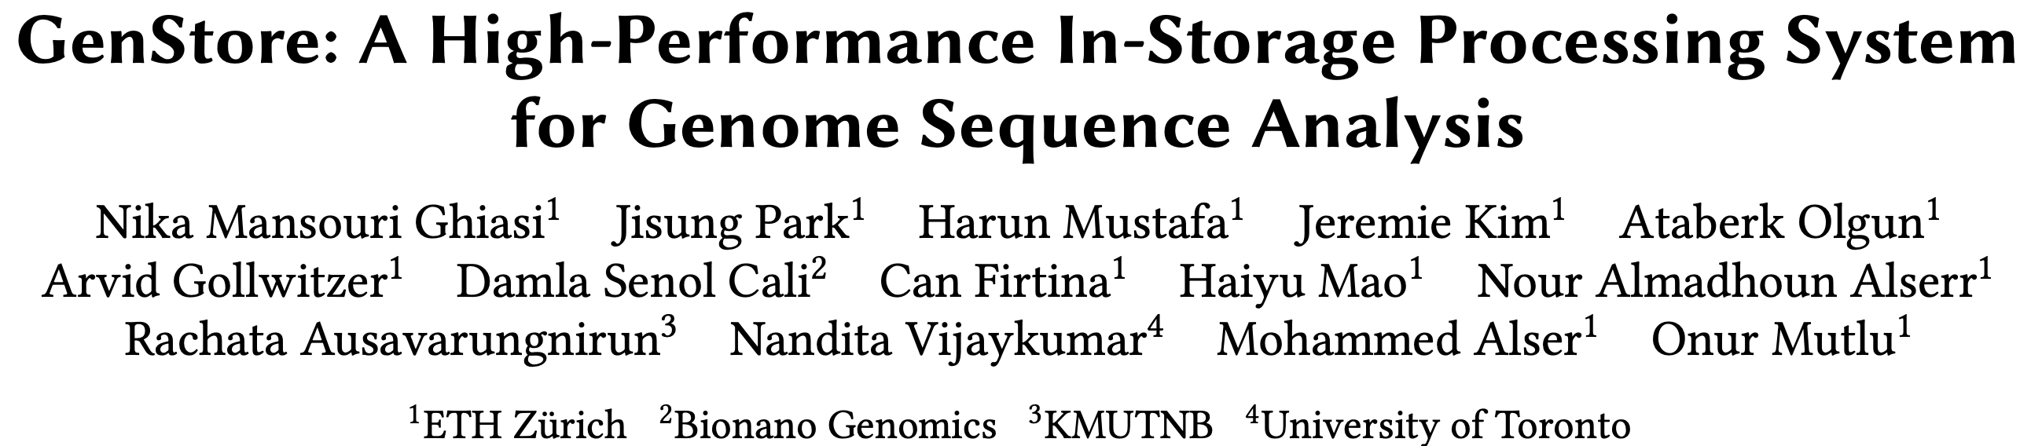
In-Storage Genome Filtering [ASPLOS 2022]
Nika Mansouri Ghiasi, Jisung Park, Harun Mustafa, Jeremie Kim, Ataberk Olgun, Arvid Gollwitzer, Damla Senol Cali, Can Firtina, Haiyu Mao, Nour Almadhoun Alserr, Rachata Ausavarungnirun, Nandita Vijaykumar, Mohammed Alser, and Onur Mutlu, "GenStore: A High-Performance and Energy-Efficient In-Storage Computing System for Genome Sequence Analysis" Proceedings of the 27th International Conference on Architectural Support for Programming Languages and Operating Systems (ASPLOS), Virtual, February-March 2022. [Talk Slides (pptx) (pdf)] [Lightning Talk Slides (pptx) (pdf)] [Lightning Talk Video (90 seconds)] [Talk Video (17 minutes)]

Slide 51
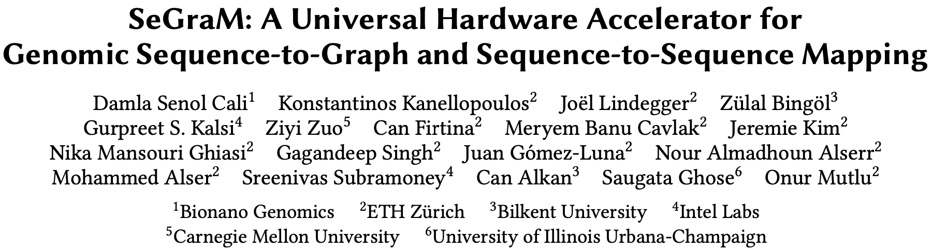
Accelerating Sequence-to-Graph Mapping
Damla Senol Cali, Konstantinos Kanellopoulos, Joel Lindegger, Zulal Bingol, Gurpreet S. Kalsi, Ziyi Zuo, Can Firtina, Meryem Banu Cavlak, Jeremie Kim, Nika MansouriGhiasi, Gagandeep Singh, Juan Gomez-Luna, Nour Almadhoun Alserr, Mohammed Alser, Sreenivas Subramoney, Can Alkan, Saugata Ghose, and Onur Mutlu, "SeGraM: A Universal Hardware Accelerator for Genomic Sequence-to-Graph and Sequence-to-Sequence Mapping" Proceedings of the 49th International Symposium on Computer Architecture (ISCA), New York, June 2022. [arXiv version]
https://arxiv.org/pdf/2205.05883.pdf

Slide 52
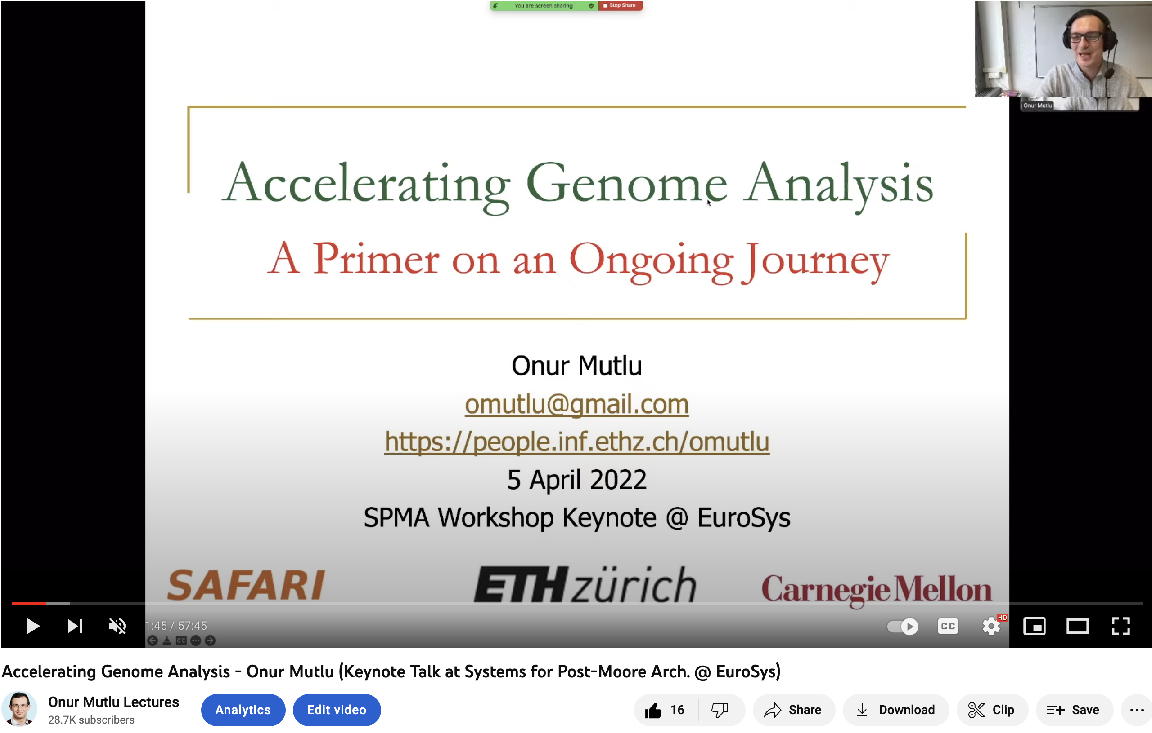
More on Fast & Efficient Genome Analysis …
https://www.youtube.com/watch?v=NCagwf0ivT0

Slide 53
Detailed Lectures on Genome Analysis
Computer Architecture, Fall 2020, Lecture 3a
Introduction to Genome Sequence Analysis (ETH Zürich, Fall 2020)
https://www.youtube.com/watch?v=CrRb32v7SJc&list=PL5Q2soXY2Zi9xidyIgBxUz7xRPS-wisBN&index=5
Computer Architecture, Fall 2020, Lecture 8
Intelligent Genome Analysis (ETH Zürich, Fall 2020)
https://www.youtube.com/watch?v=ygmQpdDTL7o&list=PL5Q2soXY2Zi9xidyIgBxUz7xRPS-wisBN&index=14
Computer Architecture, Fall 2020, Lecture 9a
GenASM: Approx. String Matching Accelerator (ETH Zürich, Fall 2020)
https://www.youtube.com/watch?v=XoLpzmN-Pas&list=PL5Q2soXY2Zi9xidyIgBxUz7xRPS-wisBN&index=15
Accelerating Genomics Project Course, Fall 2020, Lecture 1
Accelerating Genomics (ETH Zürich, Fall 2020)
https://www.youtube.com/watch?v=rgjl8ZyLsAg&list=PL5Q2soXY2Zi9E2bBVAgCqLgwiDRQDTyId
https://www.youtube.com/onurmutlulectures

Slide 54
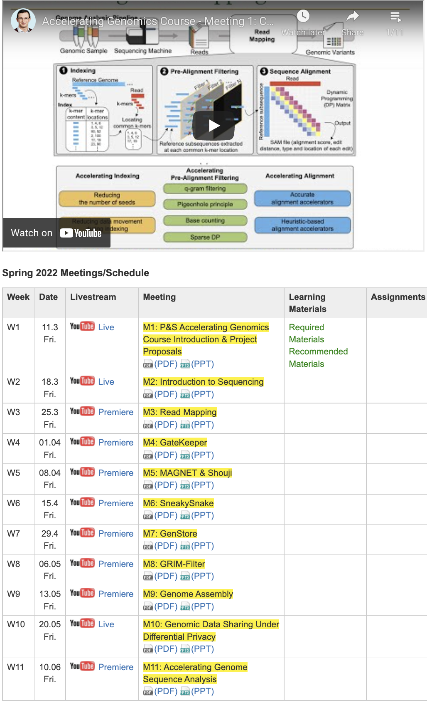
Genomics Course (Fall 2022)
Fall 2022 Edition:
https://safari.ethz.ch/projects_and_seminars/fall2022/doku.php?id=bioinformatics
Spring 2022 Edition:
https://safari.ethz.ch/projects_and_seminars/spring2022/doku.php?id=bioinformatics
Youtube Livestream (Fall 2022):
https://www.youtube.com/watch?v=nA41964-9r8&list=PL5Q2soXY2Zi8tFlQvdxOdizD_EhVAMVQV
Youtube Livestream (Spring 2022):
https://www.youtube.com/watch?v=DEL_5A_Y3TI&list=PL5Q2soXY2Zi8NrPDgOR1yRU_Cxxjw-u18
Project course
Taken by Bachelor’s/Master’s students
Genomics lectures
Hands-on research exploration
Many research readings
https://www.youtube.com/onurmutlulectures

Slide 55
Performance Perspective

Slide 56
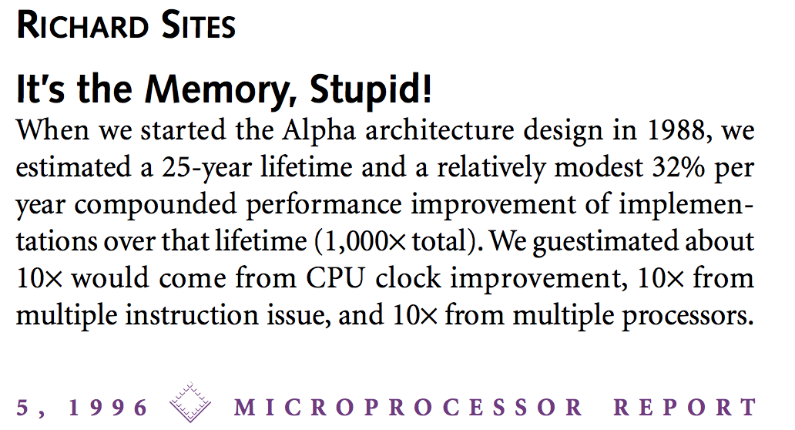
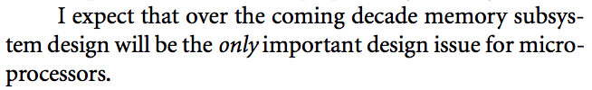
It’s the Memory, Stupid!
“It’s the Memory, Stupid!” (Richard Sites, MPR, 1996)
http://cva.stanford.edu/classes/cs99s/papers/architects_look_to_future.pdf

Slide 57
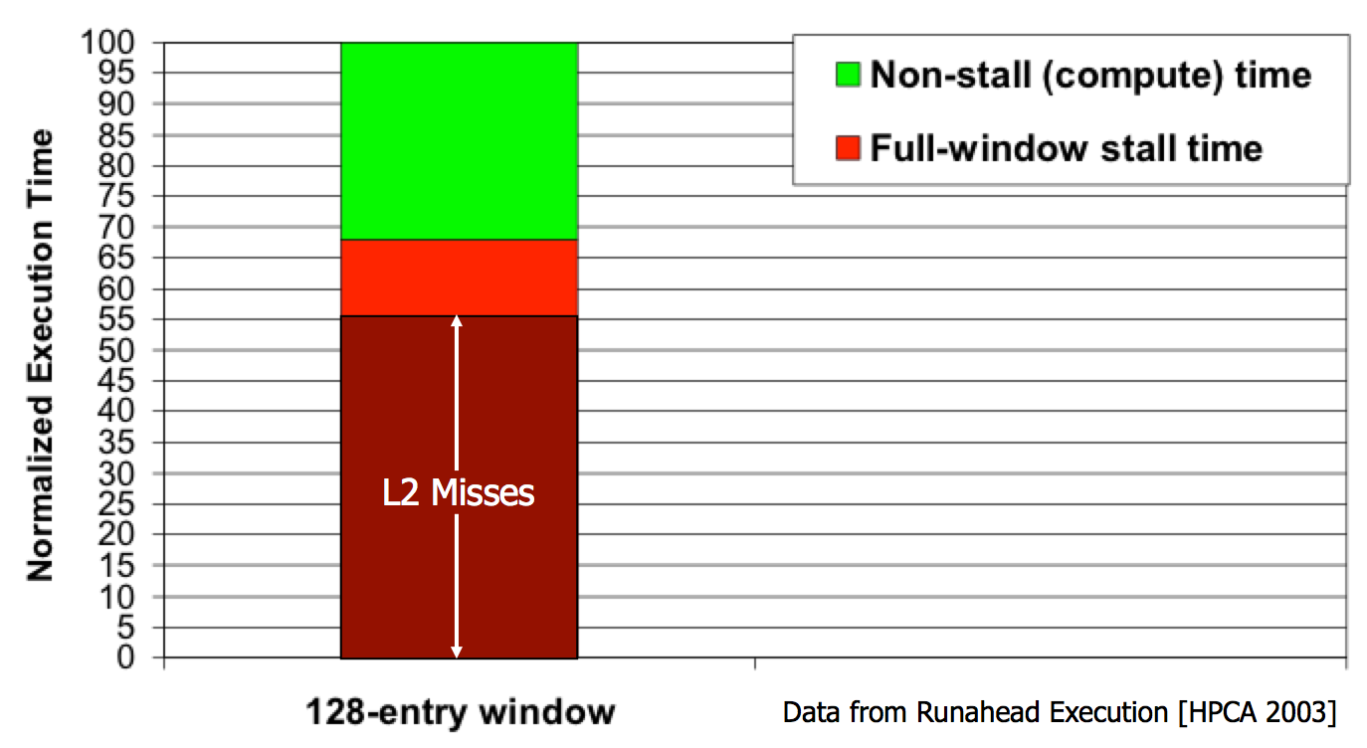
The Performance Perspective
Mutlu+, “Runahead Execution: An Alternative to Very Large Instruction Windows for Out-of-Order Processors,” HPCA 2003.

Slide 58
The Performance Perspective
Onur Mutlu, Jared Stark, Chris Wilkerson, and Yale N. Patt, "Runahead Execution: An Alternative to Very Large Instruction Windows for Out-of-order Processors" Proceedings of the 9th International Symposium on High-Performance Computer Architecture (HPCA), pages 129-140, Anaheim, CA, February 2003. Slides (pdf)
One of the 15 computer arch. papers of 2003 selected as Top Picks by IEEE Micro. HPCA Test of Time Award (awarded in 2021). [Lecture Slides (pptx) (pdf)] [Lecture Video (1 hr 54 mins)] [Retrospective HPCA Test of Time Award Talk Slides (pptx) (pdf)] [Retrospective HPCA Test of Time Award Talk Video (14 minutes)]

Slide 59
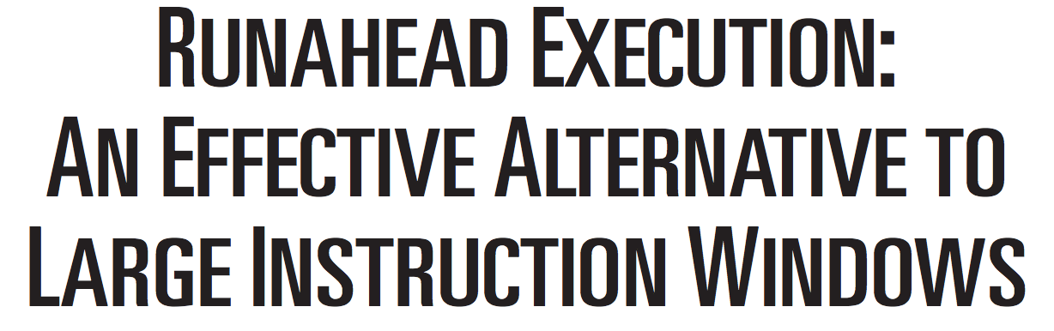
The Memory Bottleneck
Onur Mutlu, Jared Stark, Chris Wilkerson, and Yale N. Patt, "Runahead Execution: An Effective Alternative to Large Instruction Windows" IEEE Micro, Special Issue: Micro's Top Picks from Microarchitecture Conferences (MICRO TOP PICKS), Vol. 23, No. 6, pages 20-25, November/December 2003.

Slide 60
The Memory Bottleneck
All of Google’s Data Center Workloads (2015):
Kanev+, “Profiling a Warehouse-Scale Computer,” ISCA 2015.

Slide 61
The Memory Bottleneck
All of Google’s Data Center Workloads (2015):
Kanev+, “Profiling a Warehouse-Scale Computer,” ISCA 2015.

Slide 62
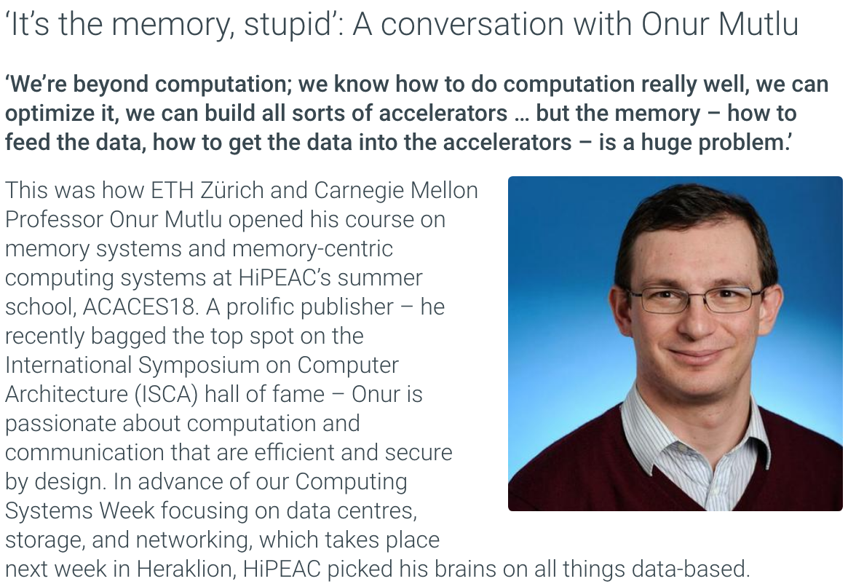
An Informal Interview on Memory
Madeleine Gray and Onur Mutlu, "‘It’s the memory, stupid’: A conversation with Onur Mutlu" HiPEAC info 55, HiPEAC Newsletter, October 2018. [Shorter Version in Newsletter] [Longer Online Version with References]

Slide 63
Energy Perspective

Slide 64
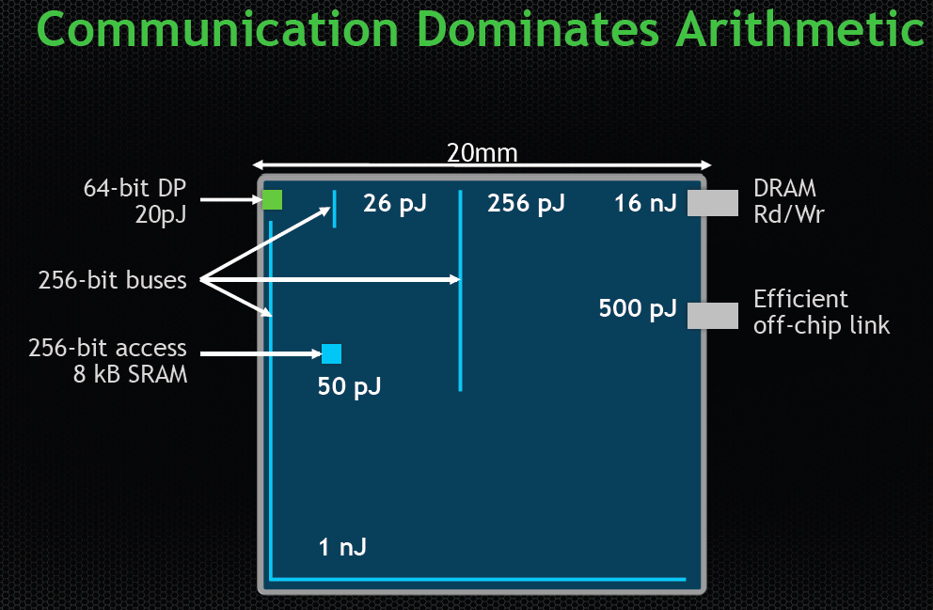
Data Movement vs. Computation Energy
Dally, HiPEAC 2015

Slide 65
Data Movement vs. Computation Energy
Dally, HiPEAC 2015
A memory access consumes ~100-1000X
the energy of a complex addition

Slide 66
Data Movement vs. Computation Energy
Han+, “EIE: Efficient Inference Engine on Compressed Deep Neural Network,” ISCA 2016.

Slide 67
Data Movement vs. Computation Energy
6400X
A memory access consumes 6400X
the energy of a simple integer addition
Han+, “EIE: Efficient Inference Engine on Compressed Deep Neural Network,” ISCA 2016.

Slide 68
Data Movement vs. Computation Energy
32-bit Operation | Energy (pJ) | ADD (int) Relative Cost
ADD (int) | 0.1 | 1
ADD (float) | 0.9 | 9
Register File | 1 | 10
MULT (int) | 3.1 | 31
MULT (float) | 3.7 | 37
SRAM Cache | 5 | 50
DRAM | 640 | 6400
A memory access consumes ~6400X
the energy of an integer addition
Han+, “EIE: Efficient Inference Engine on Compressed Deep Neural Network,” ISCA 2016.

Slide 69
Memory is Critical for Energy
Amirali Boroumand, Saugata Ghose, Youngsok Kim, Rachata Ausavarungnirun, Eric Shiu, Rahul Thakur, Daehyun Kim, Aki Kuusela, Allan Knies, Parthasarathy Ranganathan, and Onur Mutlu, "Google Workloads for Consumer Devices: Mitigating Data Movement Bottlenecks" Proceedings of the 23rd International Conference on Architectural Support for Programming Languages and Operating Systems (ASPLOS), Williamsburg, VA, USA, March 2018.
62.7% of the total system energy
is spent on data movement

Slide 70
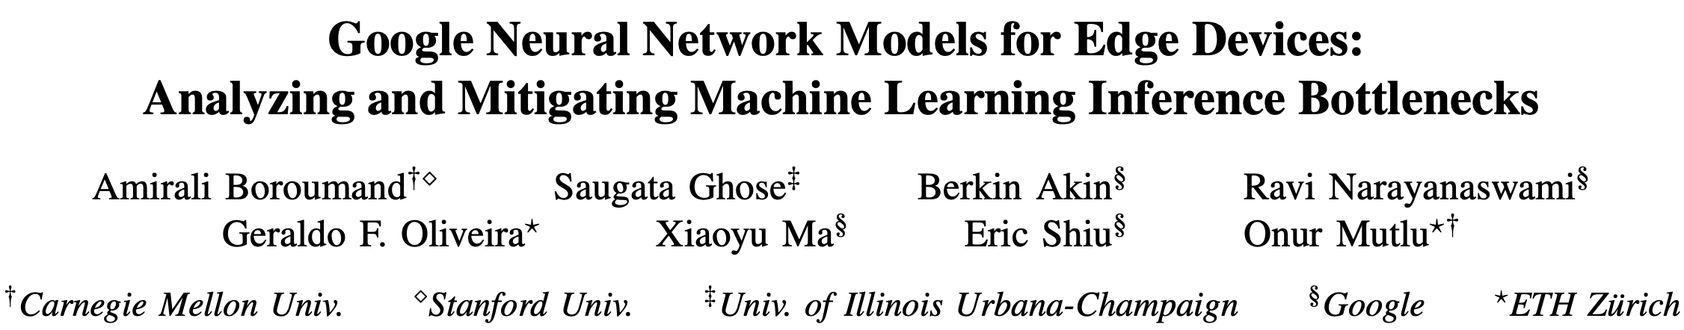
Memory is Critical for Energy
Amirali Boroumand, Saugata Ghose, Berkin Akin, Ravi Narayanaswami, Geraldo F. Oliveira, Xiaoyu Ma, Eric Shiu, and Onur Mutlu, "Google Neural Network Models for Edge Devices: Analyzing and Mitigating Machine Learning Inference Bottlenecks" Proceedings of the 30th International Conference on Parallel Architectures and Compilation Techniques (PACT), Virtual, September 2021. [Slides (pptx) (pdf)] [Talk Video (14 minutes)]
> 90% of the total system energy
is spent on memory in large ML models

Slide 71
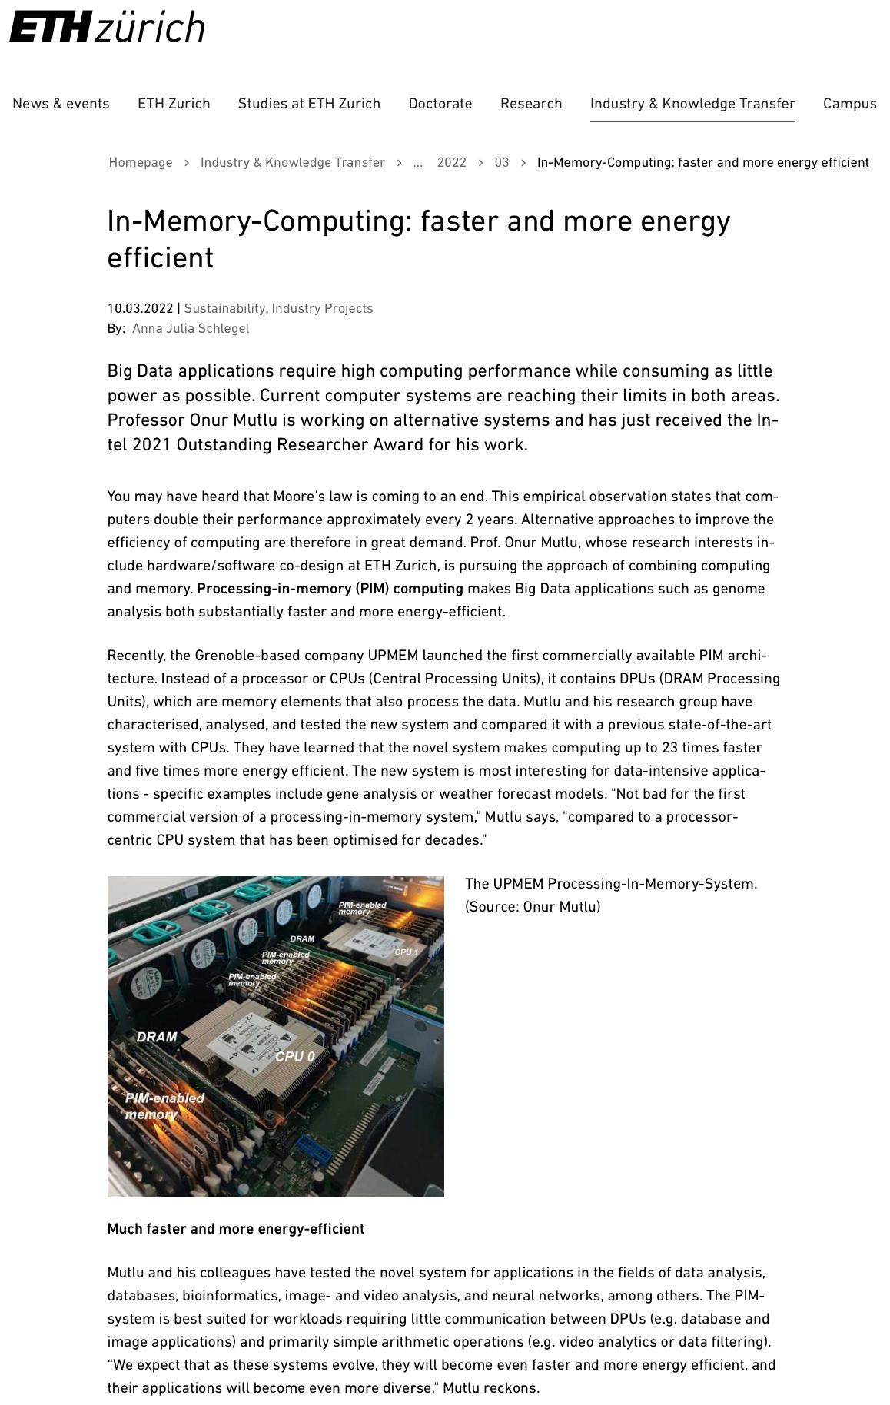

Processing in Memory: Faster & Low Energy
https://ethz.ch/en/industry/industry/news/data/2022/03/mehr-daten-schneller-und-energiesparender-verarbeiten.html

Slide 72
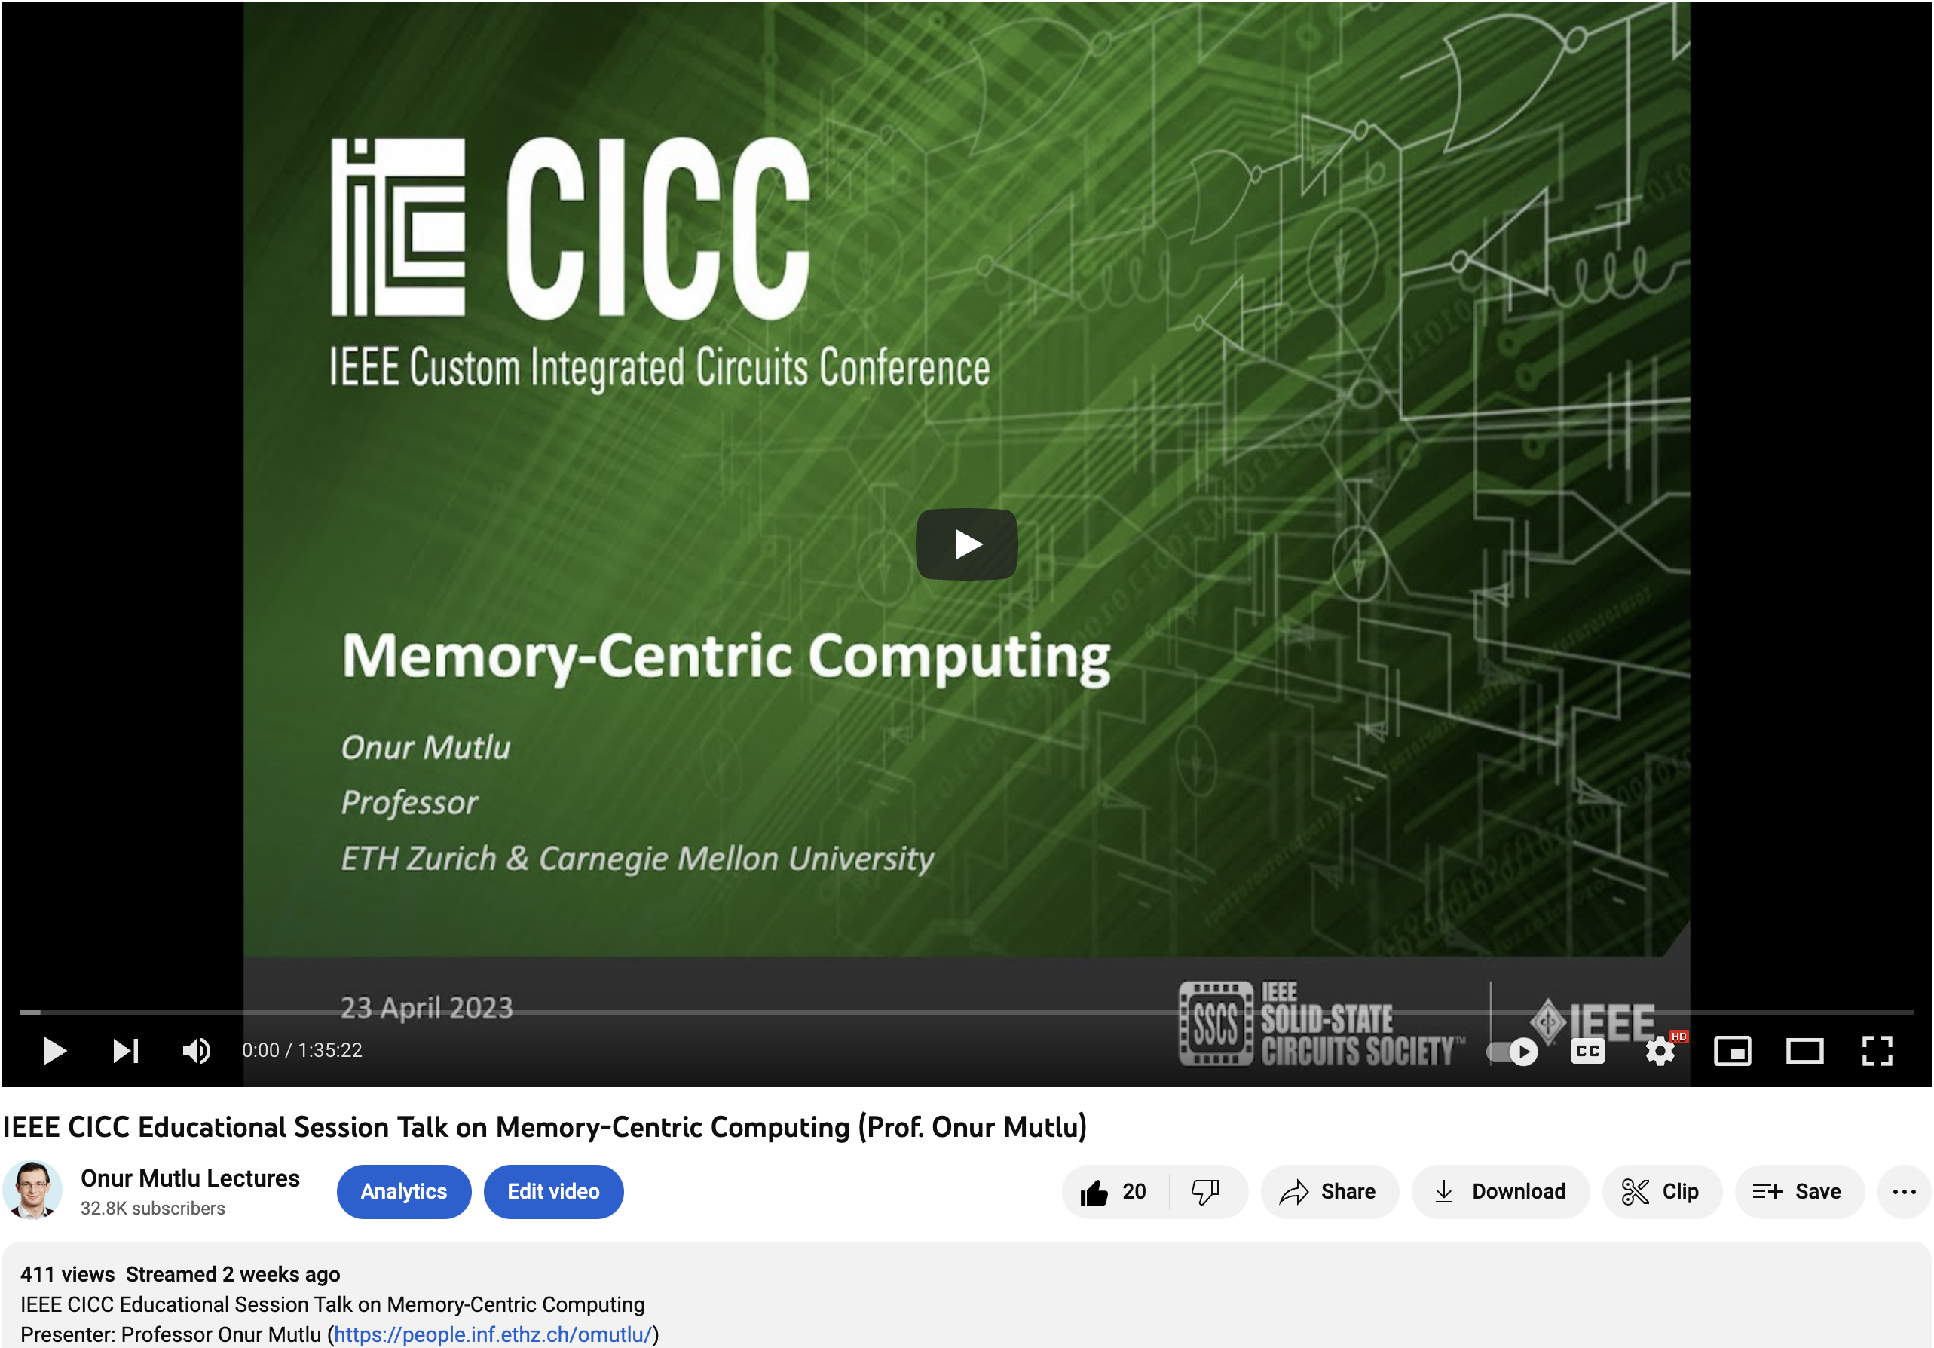
Tutorial on Processing in Memory
https://www.youtube.com/watch?v=4x9nujJtqjM
https://www.youtube.com/onurmutlulectures

Slide 73
Reliability, Security, Safety Perspectives

Slide 74
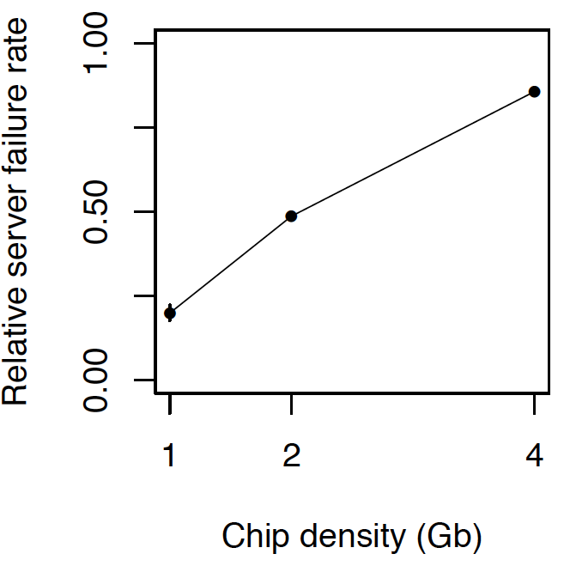
Memory is Critical for Reliability
Data from all of Facebook’s servers worldwide
Meza+, “Revisiting Memory Errors in Large-Scale Production Data Centers,” DSN’15.
As memory
capacity increases, system reliability reduces

Slide 75

Large-Scale Failure Analysis of DRAM Chips
Analysis and modeling of memory errors found in all of Facebook’s server fleet
Justin Meza, Qiang Wu, Sanjeev Kumar, and Onur Mutlu, "Revisiting Memory Errors in Large-Scale Production Data Centers: Analysis and Modeling of New Trends from the Field" Proceedings of the 45th Annual IEEE/IFIP International Conference on Dependable Systems and Networks (DSN), Rio de Janeiro, Brazil, June 2015. [Slides (pptx) (pdf)] [DRAM Error Model]

Slide 76

Infrastructures to Understand Such Issues
Temperature
Controller
FPGAs
Heater
FPGAs
PC
Kim+, “Flipping Bits in Memory Without Accessing Them: An Experimental Study of DRAM Disturbance Errors,” ISCA 2014.

Slide 77

Memory Testing Infrastructures
* SoftMC [Hassan+, HPCA’17] enhanced for DDR4
Notes:
We implement U-TRR using SoftMC, an FPGA-based infrastructure with precise temperature control which we enhanced for DDR4

Slide 78




Updated Memory Testing Infrastructure
FPGA-based SoftMC (Xilinx Virtex UltraScale+ XCU200)
*
Fine-grained control over DRAM commands,
timing (±1.5ns), temperature (±0.1°C ),
and voltage (±1mV)
*Hassan et al., "SoftMC: A Flexible and Practical Open-Source Infrastructure for Enabling Experimental DRAM Studies," in HPCA, 2017. [Available on GitHub: https://github.com/CMU-SAFARI/SoftMC]
Notes:
We use an FPGA-based experimental setup programmed with a modified version of SoftMC [CLICK]
We control the chip temperature using a pair of heaters [CLICK] connected to a temperature controller [CLICK]
We supply the wordline voltage using the VPP power rail from an external power supply [CLICK]
This infrastructure provides fine-grained control over DRAM commands, timing parameters, temperature, and wordline voltage [CLICK]
=======

Slide 79
A Curious Phenomenon [Kim et al., ISCA 2014]
One can
predictably induce errors
in most DRAM memory chips
Kim+, “Flipping Bits in Memory Without Accessing Them: An Experimental Study of DRAM Disturbance Errors,” ISCA 2014.

Slide 80

DRAM RowHammer
A simple hardware failure mechanism
can create a widespread
system security vulnerability

Slide 81



One Can Take Over an Otherwise-Secure System
Flipping Bits in Memory Without Accessing Them: An Experimental Study of DRAM Disturbance Errors (Kim et al., ISCA 2014)
Exploiting the DRAM rowhammer bug to gain kernel privileges (Seaborn+, 2015)

Slide 82

A RowHammer Survey Across the Stack
Onur Mutlu and Jeremie Kim, "RowHammer: A Retrospective" IEEE Transactions on Computer-Aided Design of Integrated Circuits and Systems (TCAD) Special Issue on Top Picks in Hardware and Embedded Security, 2019. [Preliminary arXiv version] [Slides from COSADE 2019 (pptx)] [Slides from VLSI-SOC 2020 (pptx) (pdf)] [Talk Video (1 hr 15 minutes, with Q&A)]

Slide 83

RowHammer is Still a Security Problem
Onur Mutlu, Ataberk Olgun, and A. Giray Yaglikci, "Fundamentally Understanding and Solving RowHammer" Invited Special Session Paper at the 28th Asia and South Pacific Design Automation Conference (ASP-DAC), Tokyo, Japan, January 2023. [arXiv version] [Slides (pptx) (pdf)] [Talk Video (26 minutes)]
https://arxiv.org/pdf/2211.07613.pdf

Slide 84


Memory is Critical for Security
Notes:
Picture from the article:
http://thehackernews.com/2015/03/dram-rowhammer-vulnerability.html

Slide 85

The Story of RowHammer Tutorial …
https://www.youtube.com/watch?v=e6G_Vbrqr_c&list=PL5Q2soXY2Zi9uIibswgf8IfNGKYktIEos&index=4

Slide 86

The Story of RowHammer Tutorial …
Onur Mutlu, "Security Aspects of DRAM: The Story of RowHammer" Invited Tutorial at 14th IEEE Electron Devices Society International Memory Workshop (IMW), Dresden, Germany, May 2022. [Slides (pptx)(pdf)] [Tutorial Video (57 minutes)]
https://www.youtube.com/watch?v=37hWglkQRG0

Slide 87

10 Years of RowHammer in 20 Minutes
Onur Mutlu, "The Story of RowHammer" Invited Talk at the Workshop on Robust and Safe Software 2.0 (RSS2), held with the 27th International Conference on Architectural Support for Programming Languages and Operating Systems (ASPLOS), Virtual, 28 February 2022. [Slides (pptx) (pdf)]
https://www.youtube.com/watch?v=ctKTRyi96Bk

Slide 88
Memory Is Critical for Computing

Slide 89
Memory Is Critical for Computing
Performance
Energy
Reliability
Security & Safety
Cost
Form Factor
Quality of Service & Predictability
Sustainability
…

Slide 90
Memory Fundamentals

Slide 91
Memory Organization & Technology

Slide 92

Memory (Programmer’s View)

Slide 93
Abstraction: Virtual vs. Physical Memory
Programmer sees virtual memory
Can assume the memory is “infinite”
Reality: Physical memory size is much smaller than what the programmer assumes
The system (system software + hardware, cooperatively) maps virtual memory addresses to physical memory
The system automatically manages the physical memory space transparently to the programmer
+ Programmer does not need to know the physical size of memory nor manage it → A small physical memory can appear as a huge one to the programmer → Life is easier for the programmer
-- More complex system software and architecture
A classic example of the programmer/(micro)architect tradeoff
Requires indirection and mapping between virtual and physical address spaces

Slide 94
(Physical) Memory System
You need a larger level of storage to manage a small amount of physical memory automatically
→ Physical memory has a backing store: disk
We will first start with the physical memory system
For now, ignore the virtual→physical indirection
We will get back to it later, if time permits…

Slide 95
Idealism
Pipeline
(Instruction
Execution)
Instruction
Supply
Data
Supply
- Zero latency access
- Infinite capacity
- Zero cost
- Perfect control flow
No pipeline stalls
Perfect data flow
(no reg/memory dependences)
Zero-cycle interconnect
(operand communication)
Enough functional units
Zero latency compute
Zero latency access
Infinite capacity
- Infinite bandwidth
Zero cost

Slide 96
Ideal Memory
Zero access time (latency)
Infinite capacity
Zero cost
Infinite bandwidth (to support multiple accesses in parallel)
Zero energy

Slide 97
Quick Overview of Memory Arrays

Slide 98
How Can We Store Data?
Flip-Flops (or Latches)
Very fast
Very expensive (one bit costs tens of transistors)
Static RAM (we will describe it soon)
Relatively fast
Expensive (one bit costs 6+ transistors)
Dynamic RAM (we will describe it soon)
Slower, reading and charge leakage destroys content (refresh), needs special process for manufacturing (due to capacitor)
Cheap (one bit costs only one transistor plus one capacitor)
Other storage technology (flash memory, hard disk, tape)
Much slower, special manufacturing needed, non-volatile
Very cheap (one transistor stores many bits or no transistors involved)

Slide 99
Array Organization of Memories
Goal: Efficiently store large amounts of data
A memory array (stores data)
Address selection logic (selects one row of the array)
Readout circuitry (reads data out)
An M-bit value can be read or written at each unique N-bit address
All values can be accessed, but only M-bits at a time
Access restriction allows more compact organization

Slide 100
Recall: A Bigger Memory Array (4 locations X 3 bits)
Addr[1:0]
D_{i}[2]
D_{i}[1]
D_{i}[0]
WE
Address Decoder
Multiplexer
D[2]
D[1]
D[0]
DDCA Lecture 5
https://www.youtube.com/watch?v=AFK2nL8aaZk&list=PL5Q2soXY2Zi-EImKxYYY1SZuGiOAOBKaf&index=6

Slide 101
Memory Arrays
Two-dimensional array of bit cells
Each bit cell stores one bit
An array with N address bits and M data bits:
2^{N} rows and M columns
Depth: number of rows (can be number of “words”)
Width: number of columns (can be the “word” size)
Array size: depth × width (rows x columns) = 2^{N} × M

Slide 102
Memory Array Example
2² × 3-bit array
Number of rows: 4
Row size: 3 bits
For example, the 3-bit data stored at row 10 is 100

Slide 103
Larger and Wider Memory Array Example

Slide 104
Memory Array Organization (I)
Storage nodes in one column connected to one bitline
Address decoder activates only ONE wordline
Content of one line of storage available at output

Slide 105
Memory Array Organization (II)
Storage nodes in one column connected to one bitline
Address decoder activates only ONE wordline
Content of one line of storage available at output
Active wordline
10
1
0
0

Slide 106
How is Access Controlled?
Access transistors (that are configured as switches) connect the bit storage to the bitline
Access is controlled by the wordline
DRAM
SRAM

Slide 107
Building Larger Memories
Requires larger memory arrays
Large → slow
How do we make the memory large without making it too slow?
Idea: Divide the memory into smaller arrays and interconnect the arrays to input/output buses
Large memories are hierarchical array structures
DRAM: Channel → Rank → Bank → Subarrays → Mats

Slide 108
General Principle: Interleaving (Banking)
Interleaving (banking)
Problem: a single monolithic large memory array takes long to access and does not enable multiple accesses in parallel
Goal: Reduce the latency of memory array access and enable multiple accesses in parallel
Idea: Divide a monolithic large array into multiple banks that can be accessed independently (in the same cycle or in consecutive cycles)
Each bank is smaller than the entire memory storage
Accesses to different banks can be overlapped
A Key Issue: How do you map data to different banks? (i.e., how do you interleave data across banks?)

Slide 109
Recall: Memory Banking
Memory is divided into banks that can be accessed independently; banks share address and data buses (to reduce memory chip pins)
Can start and complete one bank access per cycle
Can sustain N concurrent accesses if all N go to different banks
Bank
0
Bank
1
Bank
2
Bank
15
MDR
MAR
MDR
MAR
MDR
MAR
MDR
MAR
Data bus
Address bus
CPU
DDCA Lecture 19
https://www.youtube.com/watch?v=gkMaO3yJMz0&list=PL5Q2soXY2Zi-EImKxYYY1SZuGiOAOBKaf&index=24

Slide 110

Generalized Memory Structure

Slide 111

Generalized Memory Structure
Kim+, “A Case for Exploiting Subarray-Level Parallelism in DRAM,” ISCA 2012.
Lee+, “Decoupled Direct Memory Access,” PACT 2015.

Slide 112


Cutting Edge: 3D-Stacking of Memory & Logic
Memory
Logic
Other “True 3D” technologies
under development

Slide 113
The DRAM Subsystem A Top-Down View

Slide 114
DRAM Subsystem Organization
Channel
DIMM
Rank
Chip
Bank
Row/Column

Slide 115


The DRAM Subsystem
“Channel”
DIMM (Dual in-line memory module)
Processor
Memory channel
Memory channel

Slide 116



Breaking down a DIMM (module)
DIMM (Dual in-line memory module)
Side view
Front of DIMM
Back of DIMM

Slide 117
Breaking down a DIMM (module)
DIMM (Dual in-line memory module)
Side view
Front of DIMM
Back of DIMM
Rank 0: collection of 8 chips
Rank 1

Slide 118
Rank
Rank 0 (Front)
Rank 1 (Back)
<0:63>
<0:63>
Addr/Cmd
CS <0:1>
Data <0:63>
Memory channel

Slide 119
Breaking down a Rank
. . .
Chip 0
Chip 1
Chip 7
Rank 0
<0:63>
<0:7>
<8:15>
<56:63>
Data <0:63>

Slide 120
Breaking down a Chip
8 banks
Chip 0
Bank 0
<0:7>
<0:7>
<0:7>
...
<0:7>
<0:7>

Slide 121
Breaking down a Bank
2kB
1B (column)
row 32k-1
Bank 0
...
row 0
<0:7>
Row-buffer
1B
1B
1B
...
<0:7>

Slide 122
Digging Deeper: DRAM Bank Operation
Access Address:
(Row 0, Column 0)
Columns
This view of a bank is an abstraction.
Internally, a bank consists of many cells (transistors & capacitors) and other structures that enable access
to cells
(Row 0, Column 1)
(Row 0, Column 85)
(Row 1, Column 0)
Row address 0
Row address 1
Row decoder
Rows
Row Buffer
CONFLICT !
HIT
Row 1
HIT
Row 0
Empty
Column address 0
Column mux
Column address 0
Column address 1
Column address 85
Data

Slide 123

A DRAM Bank Internally Has Sub-Banks
Kim et al., “A Case for Exploiting Subarray-Level Parallelism in DRAM,” ISCA 2012.

Slide 124


Another View of a DRAM Bank
Logical Abstraction
Physical View
Seshadri+, “In-DRAM Bulk Bitwise Execution Engine,” ADCOM 2020.

Slide 125

More on DRAM Basics & Organization
Vivek Seshadri and Onur Mutlu, "In-DRAM Bulk Bitwise Execution Engine" Invited Book Chapter in Advances in Computers, 2020. [Preliminary arXiv version]
See Section 2 for comprehensive DRAM Background
https://arxiv.org/pdf/1905.09822.pdf

Slide 126
DRAM Subsystem Organization
Channel
DIMM
Rank
Chip
Bank
Row/Column

Slide 127



Example: Transferring a cache block
Physical memory space
0xFFFF…F
Channel 0
...
DIMM 0
Mapped to
0x40
Rank 0
64B
cache block
0x00

Slide 128
Example: Transferring a cache block
Physical memory space
Chip 0
Chip 1
Rank 0
Chip 7
0xFFFF…F
. . .
...
<0:7>
<8:15>
<56:63>
0x40
64B
cache block
Data <0:63>
0x00

Slide 129
Example: Transferring a cache block
Physical memory space
Chip 0
Chip 1
Rank 0
Chip 7
0xFFFF…F
. . .
Row 0
Col 0
...
<0:7>
<8:15>
<56:63>
0x40
64B
cache block
Data <0:63>
0x00

Slide 130
Example: Transferring a cache block
Physical memory space
Chip 0
Chip 1
Rank 0
Chip 7
0xFFFF…F
. . .
Row 0
Col 0
...
<0:7>
<8:15>
<56:63>
0x40
64B
cache block
Data <0:63>
8B
0x00
8B

Slide 131
Example: Transferring a cache block
Physical memory space
Chip 0
Chip 1
Rank 0
Chip 7
0xFFFF…F
. . .
Row 0
Col 1
...
<0:7>
<8:15>
<56:63>
0x40
64B
cache block
Data <0:63>
8B
0x00

Slide 132
Example: Transferring a cache block
Physical memory space
Chip 0
Chip 1
Rank 0
Chip 7
0xFFFF…F
. . .
Row 0
Col 1
...
<0:7>
<8:15>
<56:63>
0x40
8B
64B
cache block
Data <0:63>
8B
0x00
8B

Slide 133
Example: Transferring a cache block
Physical memory space
Chip 0
Chip 1
Rank 0
Chip 7
0xFFFF…F
. . .
Row 0
Col 1
...
<0:7>
<8:15>
<56:63>
0x40
8B
64B
cache block
Data <0:63>
8B
0x00
A 64B cache block takes 8 I/O cycles to transfer.
During the process, 8 columns are read sequentially.

Slide 134
Memory Technology: DRAM and SRAM

Slide 135
Memory Technology: DRAM
Dynamic random access memory
Capacitor charge state indicates stored value
Whether the capacitor is charged or discharged indicates storage of 1 or 0
1 capacitor
1 access transistor
Capacitor leaks through the RC path
DRAM cell loses charge over time
DRAM cell needs to be refreshed
row enable
bitline

Slide 136
Memory Technology: SRAM
Static random access memory
Two cross coupled inverters store a single bit
Feedback path enables the stored value to stay in the “cell” (as long as powered on)
4 transistors for storage
2 transistors for access
row enable
bitline
_bitline

Slide 137

Memory Bank Organization and Operation
Read access sequence:
1. Decode row address & drive word-lines
2. Selected bits drive bit-lines
• Entire row read
3. Amplify row data
4. Decode column address & select subset of row
• Send to output
5. Precharge bit-lines
• For next access

Slide 138
SRAM (Static Random Access Memory)
Read Sequence
1. address decode
2. drive row enable
3. selected bit-cells drive bitlines
(entire row is read together)
4. differential sensing and column select
(data is ready)
5. precharge all bitlines
(for next read or write)
Access latency dominated by steps 2 and 3
Cycling time dominated by steps 2, 3 and 5
step 2 proportional to 2^{m}
step 3 and 5 proportional to 2^{n}
row enable
bitline
_bitline
bit-cell array
2^{n} row x 2^{m}-col
(n≈m to minimize
overall latency)
n+m
n
2^{n}
m
2^{m} diff pairs
sense amp and mux
1

Slide 139
DRAM (Dynamic Random Access Memory)
row enable
Bit stored as charge on node capacitor (non-restorative)
bit cell loses charge when read
bit cell loses charge over time
Read Sequence
1~3 same as SRAM
4. a “flip-flopping” sense amp amplifies and regenerates the bitline, data bit is mux’ed out
5. precharge all bitlines
Destructive reads
Charge loss over time
Refresh: A DRAM controller must periodically read each row within the allowed refresh time (10s of ms) such that charge is restored
_bitline
RAS
bit-cell array
2^{n} row x 2^{m}-col
(n≈m to minimize
overall latency)
n
2^{n}
m
2^{m}
sense amp and mux
1
A DRAM die comprises
of multiple such arrays
CAS

Slide 140
DRAM vs. SRAM
DRAM
Slower access (capacitor)
Higher density (1T 1C cell)
Lower cost
Requires refresh (power, performance, circuitry)
Manufacturing requires putting capacitor and logic together
SRAM
Faster access (no capacitor)
Lower density (6T cell)
Higher cost
No need for refresh
Manufacturing compatible with logic process (no capacitor)

Slide 141

An Aside: Phase Change Memory
Phase change material (chalcogenide glass) exists in two states:
Amorphous: Low optical reflexivity and high electrical resistivity
Crystalline: High optical reflexivity and low electrical resistivity
PCM is resistive memory: High resistance (0), Low resistance (1)
Lee, Ipek, Mutlu, Burger, “Architecting Phase Change Memory as a Scalable DRAM Alternative,” ISCA 2009.

Slide 142


PCM-based Main Memory
How should PCM-based (main) memory be organized?
Pure PCM main memory [Lee et al., ISCA’09, Top Picks’10]
How to redesign the system to tolerate PCM shortcomings
Hybrid PCM+DRAM [Qureshi+ ISCA’09, Dhiman+ DAC’09]
How to partition/migrate data between PCM and DRAM

Slide 143

Reading: PCM as Main Memory: Idea in 2009
Benjamin C. Lee, Engin Ipek, Onur Mutlu, and Doug Burger, "Architecting Phase Change Memory as a Scalable DRAM Alternative" Proceedings of the 36th International Symposium on Computer Architecture (ISCA), pages 2-13, Austin, TX, June 2009. Slides (pdf) One of the 13 computer architecture papers of 2009 selected as Top Picks by IEEE Micro. Selected as a CACM Research Highlight. 2022 Persistent Impact Prize.

Slide 144

Reading: More on PCM As Main Memory
Benjamin C. Lee, Ping Zhou, Jun Yang, Youtao Zhang, Bo Zhao, Engin Ipek, Onur Mutlu, and Doug Burger, "Phase Change Technology and the Future of Main Memory" IEEE Micro, Special Issue: Micro's Top Picks from 2009 Computer Architecture Conferences (MICRO TOP PICKS), Vol. 30, No. 1, pages 60-70, January/February 2010.

Slide 145
Intel Optane Persistent Memory (2019)
Non-volatile main memory
Based on 3D-XPoint Technology
https://www.storagereview.com/intel_optane_dc_persistent_memory_module_pmm

Slide 146
DRAM vs. PCM
DRAM
Faster access (capacitor)
Lower density (capacitor less scalable) → higher cost
Requires refresh (power, performance, circuitry)
Manufacturing requires putting capacitor and logic together
Volatile (loses data at loss of power)
No endurance problems
Lower access energy
PCM
Slower access (heating and cooling based ”phase change” operation)
Higher density (phase change material more scalable) → lower cost
No need for refresh
Manufacturing requires less conventional processes – less mature
Non-volatile (does not lose data at loss of power)
Endurance problems (a cell cannot be used after N writes to it)
Higher access energy

Slide 147
Charge vs. Resistive Memories
Charge Memory (e.g., DRAM, Flash)
Write data by capturing charge Q
Read data by detecting voltage V
Resistive Memory (e.g., PCM, STT-MRAM, memristors)
Write data by pulsing current dQ/dt
Read data by detecting resistance R

Slide 148
Promising Resistive Memory Technologies
PCM
Inject current to change material phase
Resistance determined by phase
STT-MRAM
Inject current to change magnet polarity
Resistance determined by polarity
Memristors/RRAM/ReRAM
Inject current to change atomic structure
Resistance determined by atom distance

Slide 149

More on Emerging Memory Technologies
https://www.youtube.com/watch?v=AlE1rD9G_YU&list=PL5Q2soXY2Zi9xidyIgBxUz7xRPS-wisBN&index=28

Slide 150

More on Emerging Memory Technologies
https://www.youtube.com/watch?v=pmLszWGmMGQ&list=PL5Q2soXY2Zi9xidyIgBxUz7xRPS-wisBN&index=29

Slide 151

More on Memory Technologies
https://www.youtube.com/watch?v=pmLszWGmMGQ&list=PL5Q2soXY2Zi9xidyIgBxUz7xRPS-wisBN&index=29

Slide 152
A Bit on Flash Memory & SSDs
Flash memory was a very “doubtful” emerging technology
for at least two decades
Proceedings of the IEEE, Sept. 2017
https://arxiv.org/pdf/1711.11427.pdf

Slide 153
A Flash Memory SSD Controller
Cai+, “Error Characterization, Mitigation, and Recovery in Flash Memory Based Solid State Drives,” Proc. IEEE 2017.
https://arxiv.org/pdf/1711.11427.pdf

Slide 154

Lecture on Flash Memory & SSDs
https://www.youtube.com/watch?v=rninK6KWBeM&list=PL5Q2soXY2Zi9xidyIgBxUz7xRPS-wisBN&index=47

Slide 155

SSD Course (Spring 2023)
Spring 2023 Edition:
https://safari.ethz.ch/projects_and_seminars/spring2023/doku.php?id=modern_ssds
Fall 2022 Edition:
https://safari.ethz.ch/projects_and_seminars/fall2022/doku.php?id=modern_ssds
Youtube Livestream (Spring 2023):
https://www.youtube.com/watch?v=4VTwOMmsnJY&list=PL5Q2soXY2Zi_8qOM5Icpp8hB2SHtm4z57&pp=iAQB
Youtube Livestream (Fall 2022):
https://www.youtube.com/watch?v=hqLrd-Uj0aU&list=PL5Q2soXY2Zi9BJhenUq4JI5bwhAMpAp13&pp=iAQB
Project course
Taken by Bachelor’s/Master’s students
SSD Basics and Advanced Topics
Hands-on research exploration
Many research readings
https://www.youtube.com/onurmutlulectures

Slide 156
Lectures on Memory Technologies
Computer Architecture, Fall 2020, Lecture 15
Emerging Memory Technologies (ETH, Fall 2020)
https://www.youtube.com/watch?v=AlE1rD9G_YU&list=PL5Q2soXY2Zi9xidyIgBxUz7xRPS-wisBN&index=28
Computer Architecture, Fall 2020, Lecture 16a
Opportunities & Challenges of Emerging Memory Tech (ETH, Fall 2020)
https://www.youtube.com/watch?v=pmLszWGmMGQ&list=PL5Q2soXY2Zi9xidyIgBxUz7xRPS-wisBN&index=29
Computer Architecture, Fall 2020, Lecture 3b
Memory Systems: Challenges & Opportunities (ETH, Fall 2020)
https://www.youtube.com/watch?v=Q2FbUxD7GHs&list=PL5Q2soXY2Zi9xidyIgBxUz7xRPS-wisBN&index=6
https://www.youtube.com/onurmutlulectures

Slide 157
Tutorial on Processing in Memory
https://www.youtube.com/watch?v=4x9nujJtqjM
https://www.youtube.com/onurmutlulectures

Slide 158

Processing in Memory Review and Open Problems
Onur Mutlu, Saugata Ghose, Juan Gomez-Luna, and Rachata Ausavarungnirun, "A Modern Primer on Processing in Memory" Invited Book Chapter in Emerging Computing: From Devices to Systems - Looking Beyond Moore and Von Neumann, Springer, to be published in 2021.
https://arxiv.org/pdf/2012.03112.pdf

Slide 159

PIM Course (Fall 2022)
Fall 2022 Edition:
https://safari.ethz.ch/projects_and_seminars/fall2022/doku.php?id=processing_in_memory
Spring 2022 Edition:
https://safari.ethz.ch/projects_and_seminars/spring2022/doku.php?id=processing_in_memory
Youtube Livestream (Fall 2022):
https://www.youtube.com/watch?v=QLL0wQ9I4Dw&list=PL5Q2soXY2Zi8KzG2CQYRNQOVD0GOBrnKy
Youtube Livestream (Spring 2022):
https://www.youtube.com/watch?v=9e4Chnwdovo&list=PL5Q2soXY2Zi-841fUYYUK9EsXKhQKRPyX
Project course
Taken by Bachelor’s/Master’s students
Processing-in-Memory lectures
Hands-on research exploration
Many research readings
https://www.youtube.com/onurmutlulectures

Slide 160
Digital Design & Computer Arch. Lecture 21: Memory Overview, Organization & Technology
Prof. Onur Mutlu
ETH Zürich
Spring 2023
12 May 2023

Slide 161
Goal: Processing Inside Memory
Many questions … How do we design the:
compute-capable memory & controllers?
processors & communication units?
software & hardware interfaces?
system software, compilers, languages?
algorithms & theoretical foundations?
Memory
Processor
Core
Database
Graphs
Media
Cache
Query
Interconnect
Problem
Results
Algorithm
Program/Language
System Software
SW/HW Interface
Micro-architecture
Logic
Devices
Electrons

Slide 162
Backup Slides: Inside A DRAM Chip

Slide 163


DRAM Module and Chip

Slide 164
Goals in DRAM Design
Cost
Latency
Bandwidth
Parallelism
Power
Energy
Reliability
Security
…

Slide 165
DRAM Chip
Row Decoder
Cell Array
Array of Sense Amplifiers
Cell Array
Row Decoder
Cell Array
Array of Sense Amplifiers
Cell Array
Bank I/O

Slide 166
Sense Amplifier
top
enable
Inverter
bottom

Slide 167
Sense Amplifier – Two Stable States
V_{DD}
0
1
1
0
V_{DD}
Logical “1”
Logical “0”

Slide 168
Sense Amplifier Operation
V_{T}
V_{DD}
0
V_{T} > V_{B}
1
V_{B}
0

Slide 169
DRAM Cell – Capacitor
Empty State
Fully Charged State
Logical “0”
Logical “1”
1
Small – Cannot drive circuits
2
Reading destroys the state

Slide 170
Capacitor to Sense Amplifier
0
V_{DD}
1
1
V_{DD}
0

Slide 171
DRAM Cell Operation
½V_{DD}
½V_{DD}+δ
V_{DD}
0
1
0
½V_{DD}

Slide 172
DRAM Subarray – Building Block for DRAM Chip
Row Decoder
Cell Array
Array of Sense Amplifiers (Row Buffer) 8Kb
Cell Array

Slide 173
DRAM Bank
Row Decoder
Cell Array
Array of Sense Amplifiers (8Kb)
Cell Array
Address
Row Decoder
Cell Array
Array of Sense Amplifiers
Cell Array
Bank I/O (64b)
Data
Address

Slide 174
DRAM Chip
Shared internal bus
Row Decoder
Cell Array
Row Decoder
Cell Array
Array of Sense Amplifiers
Array of Sense Amplifiers
Cell Array
Cell Array
Row Decoder
Cell Array
Row Decoder
Cell Array
Array of Sense Amplifiers
Array of Sense Amplifiers
Row Decoder
Cell Array
Row Decoder
Cell Array
Cell Array
Cell Array
Array of Sense Amplifiers
Array of Sense Amplifiers
Bank I/O
Bank I/O
Cell Array
Cell Array
Row Decoder
Cell Array
Row Decoder
Cell Array
Array of Sense Amplifiers
Array of Sense Amplifiers
Row Decoder
Cell Array
Row Decoder
Cell Array
Cell Array
Cell Array
Array of Sense Amplifiers
Array of Sense Amplifiers
Bank I/O
Bank I/O
Cell Array
Cell Array
Row Decoder
Cell Array
Row Decoder
Cell Array
Array of Sense Amplifiers
Array of Sense Amplifiers
Row Decoder
Cell Array
Row Decoder
Cell Array
Cell Array
Cell Array
Array of Sense Amplifiers
Array of Sense Amplifiers
Bank I/O
Bank I/O
Cell Array
Cell Array
Row Decoder
Cell Array
Row Decoder
Cell Array
Array of Sense Amplifiers
Array of Sense Amplifiers
Cell Array
Cell Array
Bank I/O
Bank I/O
Memory channel - 8bits

Slide 175
DRAM Operation
Row Decoder
ACTIVATE Row
1
Row Address
2
READ/WRITE Column
Row Decoder
Cell Array
Array of Sense Amplifiers
Cell Array
3
PRECHARGE
Bank I/O
Data
Column Address

Slide 176
More on DRAM Operation: Section 2
Vivek Seshadri and Onur Mutlu, "In-DRAM Bulk Bitwise Execution Engine" Invited Book Chapter in Advances in Computers, to appear in 2020. [Preliminary arXiv version]
See Section 2 for comprehensive DRAM Background
https://arxiv.org/pdf/1905.09822.pdf

